Slide 1
Discover Leiden University

Slide 2

First university in the Netherlands
Founded by William of Orange in 1575
Our motto
Praesidium Libertatis: Bastion of Freedom
Notes:
Leiden University was founded by William of Orange and its links to the House of Orange go back centuries. Legend has it that the people of Leiden were given the choice: no taxes or a university. Our logo features Minerva, the goddess of wisdom, bearing a shield and a book. This photo of Minerva is by photographer Erwin Olaf.
(https://www.universiteitleiden.nl/en/about-us/profile/history)
Freedom of speech and thought is fundamental to our university, and we have lived for centuries by our motto, Bastion of Freedom. Nelson Mandela, Winston Churchill and Princess Beatrix (the former queen of the Netherlands) have been awarded honorary doctorates for defending freedom.
(https://www.universiteitleiden.nl/en/about-us/profile)

Slide 3
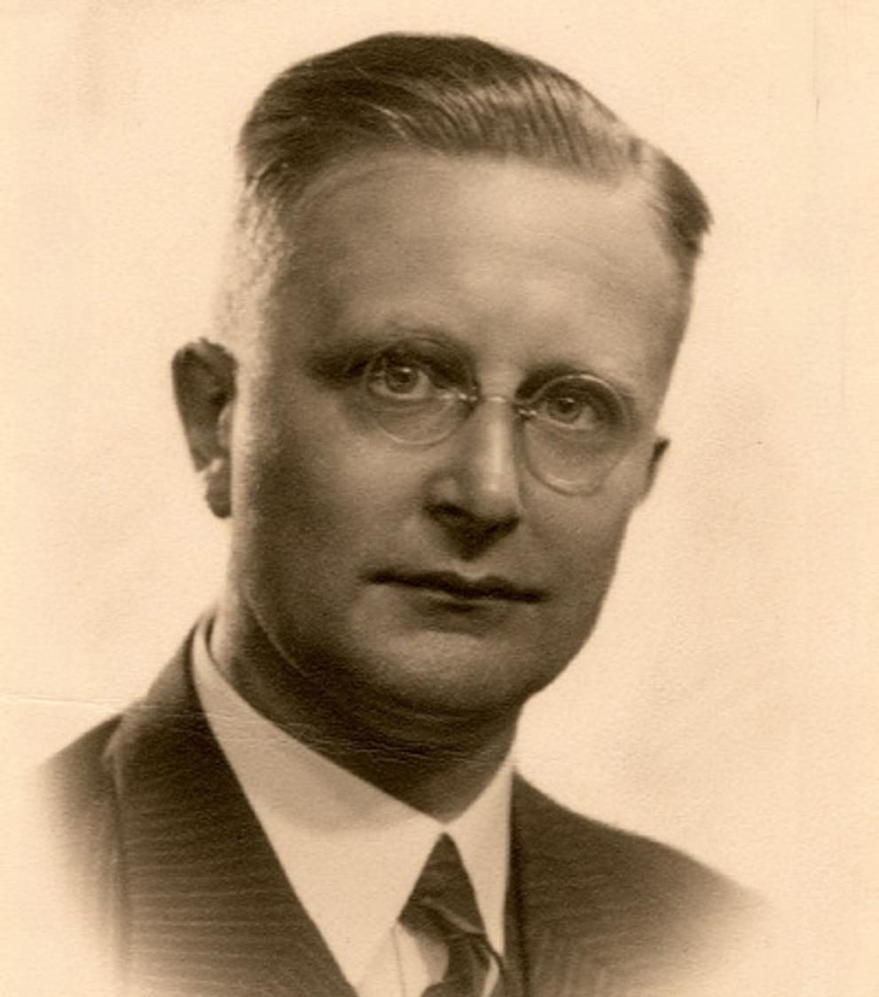
Rudolph Cleveringa
1940
Protest speech against dismissal of Jewish professors
Today
Annual Cleveringa Lecture and alumni events
Notes:
Leiden professor Rudolph Cleveringa was living by our motto when he spoke out against the dismissal of his Jewish colleagues. The German occupiers closed the university in response. One of the best-known resistance fighters was the ‘Soldier of Orange’, Erik Hazelhoff Roelfzema. We remember our victims of the war and all the members of the university community who resisted injustice.
We commemorate Rudolph Cleveringa on 26 November (the day Cleveringa gave his famous speech) each year, with the inaugural lecture of the Cleveringa Professor and meetings for alumni all around the world.
More info and list of former Cleveringa Professors:
(https://www.universiteitleiden.nl/en/dossiers/the-university-and-the-war/cleveringa-chair)

Slide 4
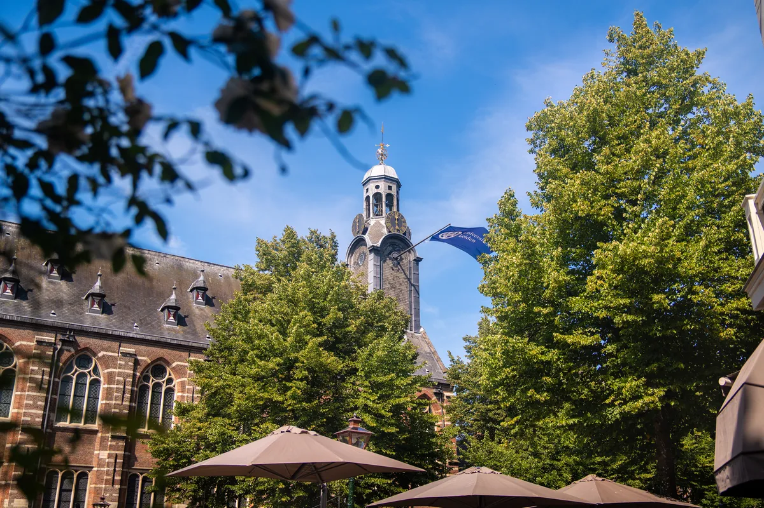
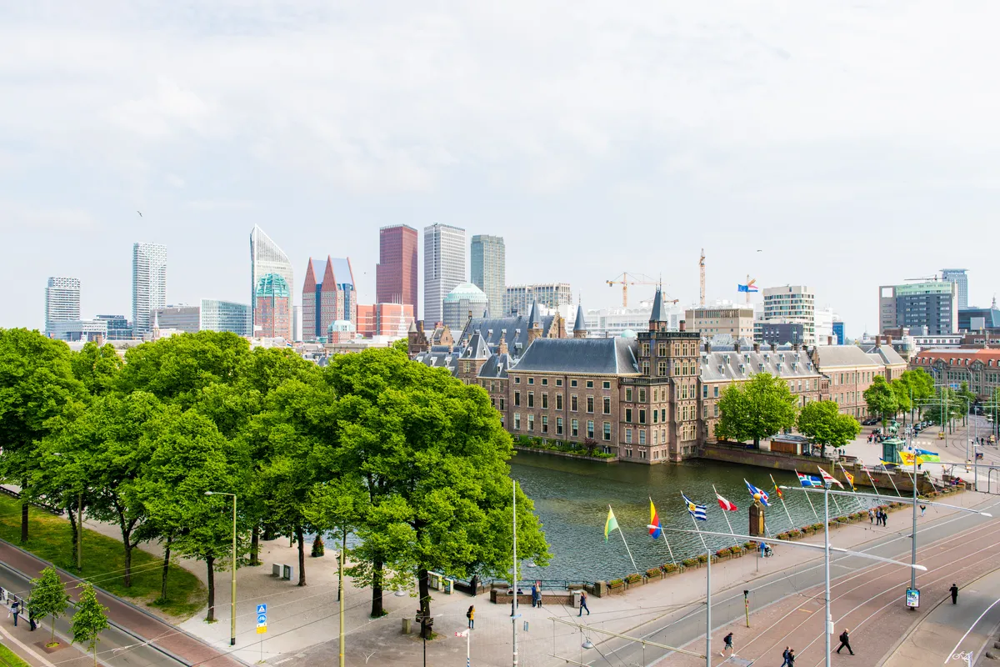
Two cities, one unique ecosystem
Medical Delta
Leiden-Delft-Erasmus Universities
Key Region Leiden
Campus The Hague
Leiden City of Knowledge
Leiden Bio Science Park
Unmanned Valley
Leiden
The Hague
NL Space Campus
Ministries and embassies
Spin-offs and start-ups
Local and regional government
Business community
Museums, culture and heritage
International
organisations
Peace, justice and security
Notes:
LDE
Since 2012, Leiden University, Delft University of Technology (TU Delft) and Erasmus University Rotterdam have collaborated through the Leiden-Delft-Erasmus (LDE) Universities strategic alliance to advance interdisciplinary and transdisciplinary research, education and operations.
LDE works with a range of organisations in a range of ways. These organisations are involved in partnerships, for example, or serve on the advisory boards of LDE centres. Others, such as government or industry, provide cases for students to study. Some of these partnerships go back years.
https://www.leiden-delft-erasmus.nl/en/home
Medical Delta
Medical Delta was founded in 2006 by the three LDE universities and the two UMCs (LUMC and Erasmus MC) in the province of Zuid-Holland. Four universities of applied sciences from the province (The Hague University of Applied Sciences, InHolland University of Applied Sciences, Rotterdam University of Applied Sciences and Leiden University of Applied Sciences) joined the collaboration in 2006.
https://www.leiden-delft-erasmus.nl/en/centres/medical-delta
Leiden City of Knowledge (Leiden Kennisstad)
Leiden University, Leiden University Medical Center (LUMC), Leiden University of Applied Sciences and the Municipality of Leiden decided in 2017 to intensify their collaboration, giving an extra boost to ‘Leiden City of Knowledge’. An evaluation of the project recommended continuing the collaboration, based on the following three themes:
Health & Well-being
Biodiversity & Sustainability
Cultural Heritage
These three themes build on the city’s strengths and relate to grand challenges that demand a national or global response. These themes should be viewed as a whole.
Key Region Leiden
Key Region Leiden (the successor to the Economie071 alliance) is a public-private partnership revolving around three leading innovation clusters, which together form the Leiden–Katwijk–Noordwijk knowledge axis. The clusters are as follows:
Leiden Bio Science Park (LBSP) – Focusing on bioscience, health and biotechnology.
NL Space Campus (Noordwijk) – Focusing on space technology and satellite data.
Unmanned Valley (Katwijk/Valkenburg) – Focusing on unmanned systems, sensors and drone technology.
NL Space Campus is the meeting place for the national and international space sector, with ESA ESTEC and the LDE universities as key partners.
Two cities
With a presence in two cities, Leiden and The Hague, our university is situated in the economic and administrative heart of the Netherlands and close to the international airport Schiphol, major cities, the Dutch coast and the centre of the EU.
Leiden
Historic city centre
Population of 130,000
City of Discoveries
Leiden Bio Science Park
Inner city campus
Museums
Six of our seven faculties
Approx. 35,000 students
Leiden is the city of discoveries, and university has been making its mark on there for over 450 years. It has two campuses and six faculties: Leiden Law School and the Faculty of Humanities in the city centre; and the Faculty of Medicine, the Faculty of Science, the Faculty of Social and Behavioural Sciences and the Faculty of Archaeology close to the Leiden Bio Science Park. Many of the museums in Leiden have close ties with the university. Six out of seven of our students study in Leiden and many live here too.
The Hague
Administrative and political capital with international organisations and embassies​
Population of 570,000
International City of Peace, Justice and Security
Campus The Hague
30 museums​
Seven faculties
Over 7,000 students
Since 1997, Leiden has also had a presence in The Hague, the third city in the Netherlands, which had no university before our arrival. Leiden is a university in two cities. All of our faculties are active in The Hague, and one faculty is solely located there: Governance and Global Affairs. The Campus The Hague strategy aligns closely with The Hague’s as a city of peace, justice and security and with the city’s metropolitan, national and international character. Many international students study here.

Slide 5
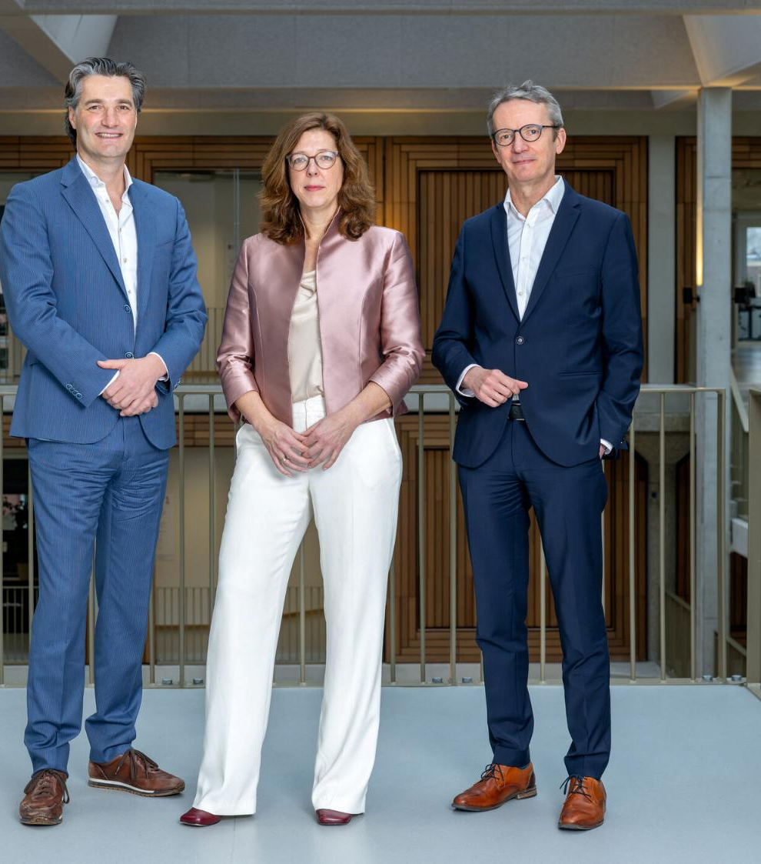
Board of Governors
Executive Board
University Council
Faculties
Archaeology
Governance and Global Affairs
Humanities
Law
Medicine/LUMC
Science
Social and Behavioural Sciences
Interfaculty institutes
Expertise centres/support services
Administration and Central Services
Notes:
The photo is of Leiden University’s Executive Board, with (l-r): Timo Kos (Vice-President), Sarah de Rijcke (Rector Magnificus) and Luc Sels (President).
The chart illustrates our organisational structure.
The university has seven faculties, all of which are based in Leiden and The Hague.
Each institute belongs to one or more faculties. Leiden University has 36 institutes, four of which are interfaculty.
https://www.universiteitleiden.nl/en/about-us/management-and-organisation/executive-board
https://www.universiteitleiden.nl/en/about-us/facts-and-figures/annual-reports

Slide 6
Faculties
Archaeology
Governance and Global Affairs
Humanities
Law
Medicine/LUMC
Science
Social and Behavioural Sciences
Notes:
Leiden University has seven faculties, located in both Leiden and The Hague. Within these faculties, academic research is carried out at various specialised research institutes. Leiden University has 36 institutes, four of which are interfaculty.
https://www.organisatiegids.universiteitleiden.nl/en/faculties-and-institutes

Slide 7
Nine institutes abroad
Rome
Royal Netherlands Institute in Rome (KNIR)
Florence
Netherlands Interuniversity Institute for Art History (NIKI)
St. Petersburg
Netherlands Institute in St. Petersburg (NIP)
Athens
Netherlands Institute at Athens (NIA)
Istanbul
Netherlands Institute in Turkey (NIT)
Rabat
Netherlands Institute Morocco (NIMAR)
Cairo
Netherlands-Flemish Institute in Cairo (NVIC)
Nairobi
Nuvoni Centre for Innovation Research (LDE)
Jakarta
Royal Netherlands Institute of Southeast Asian and Caribbean Studies (KITLV)
St, Petersburg
St, Petersburg
St, Petersburg
St, Petersburg
St, Petersburg
St, Petersburg
St, Petersburg
St, Petersburg
St, Petersburg
Notes:
We have nine institutes abroad where our students and staff can write their thesis, take a minor, work with local academics and conduct or disseminate research.
KITLV Jakarta
Netherlands Institute Morocco (NIMAR)
Netherlands-Flemish Institute in Cairo (NVIC)
Nuvoni Centre for Innovation Research in Nairobi
Netherlands Institute in Turkey (NIT)
Royal Netherlands Institute in Rome (KNIR)
Netherlands Interuniversity Institute for Art History (NIKI)
Netherlands Institute at Athens (NIA)
Netherlands Institute in St. Petersburg (NIP)

Slide 8
Leiden University in figures
2
Cities
7
Faculties
6,400
Staff members
51
Bachelor’s
programmes
83
Master’s
programmes
33,500
Students
156,000
Alumni
120
Nationalities
16
Nobel Prizes
Until now
Notes:
Figures from 2025 annual report
Exact numbers student and staff
Students: 33,494
Employees: 6,359

Slide 9
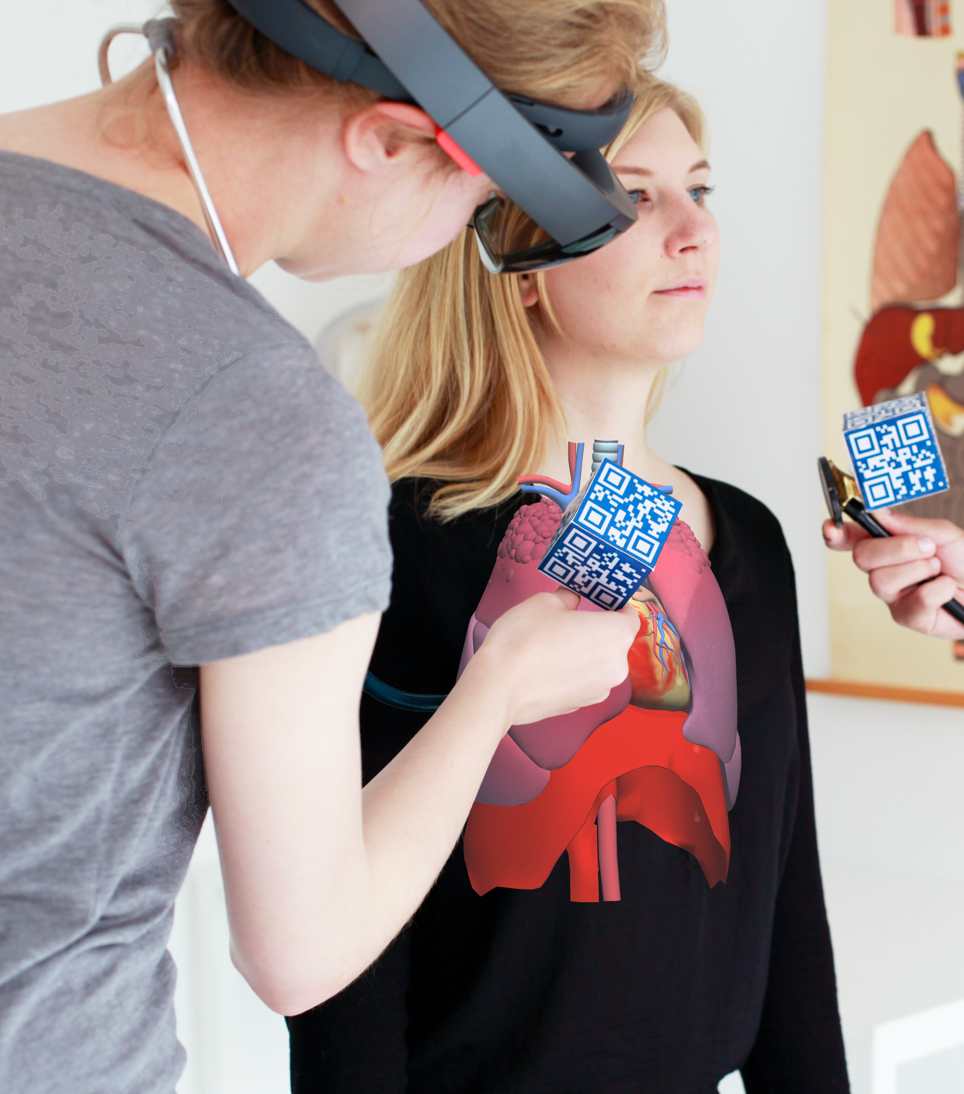
World-class research
Cutting-edge fundamental research
Interdisciplinary collaboration
Impact on society
International focus
Innovative teaching
Mono-, multi- and interdisciplinary
Focus on 21st-century skills
Relevant to society
Innovative use of technology
Notes:
RESEARCH
Our research is organised into 36 research institutes and spans a wide range of themes. Our research ranges from astronomy to nanotechnology, and from local to global challenges. We study urban issues in The Hague and children’s rights around the world.
Our Faculty of Humanities explores global languages, cultures and societies, our archaeologists uncover insights from the past, while our terrorism experts study today’s most pressing challenges.
Many of these issues are too complex for one discipline to solve. When researchers from different disciplines join forces, this results in new insights and solutions.
Our research has an impact on society. We use our knowledge to help address societal challenges, contribute to public debate and support policymaking.
TEACHING
We offer a wide range of mono-, multi- and interdisciplinary programmes. Our minors enable students to develop a multidisciplinary profile, and our new programmes are often strongly interdisciplinary.
With the world facing complex challenges that can rarely be solved by one discipline, our many interdisciplinary minors and programmes (e.g. International Studies) encourage our students to look beyond their own discipline.
We are integrating digital learning into our teaching. More than just online classes, this might involve interactive simulations, virtual environments and online collaboration tools.
Alongside research-based disciplinary knowledge, we place a firm emphasis on developing skills such as problem-solving, collaboration, communication and critical reflection. These are essential to a fast-changing job market and society, and their integration into the curriculum is innovative.
Many of our programmes and research projects have clear links to real-world challenges. Students are encouraged to think about the impact of their work on society and to seek solutions to today’s big issues. This contributes to a meaningful learning environment.

Slide 10
Interdisciplinary research and teaching
Collaboration among disciplines, researchers and teaching staff
Notes:
Interdisciplinary collaboration − when researchers from a wide range of fields work together on a research or teaching project − is an important way to find answers to the complex, pressing issues of our time.
https://www.universiteitleiden.nl/en/research/our-research-organisation/interdisciplinary-programmes

Slide 11

Profile of Leiden University
15 themes in 5 domains
Humans in the world | Resilient and learning society | Technology and society | Peace, justice, democracy and governance | Health and life sciences
Languages, cultures and worldviews Heritage Migration | Inequalities Generation of the future Social transitions | Sustainability and biodiversity Quantum and space AI for humans, society and science | Security, safety and cybersecurity Trust in polarised times Geopolitics in Europe and the world | Regenerative medicine Health and well-being Drug discovery and development
Notes:
Leiden University is a broad-based, international university. Our research and teaching is divided into five core domains.
https://universiteitleiden.nl/en/research

Slide 12
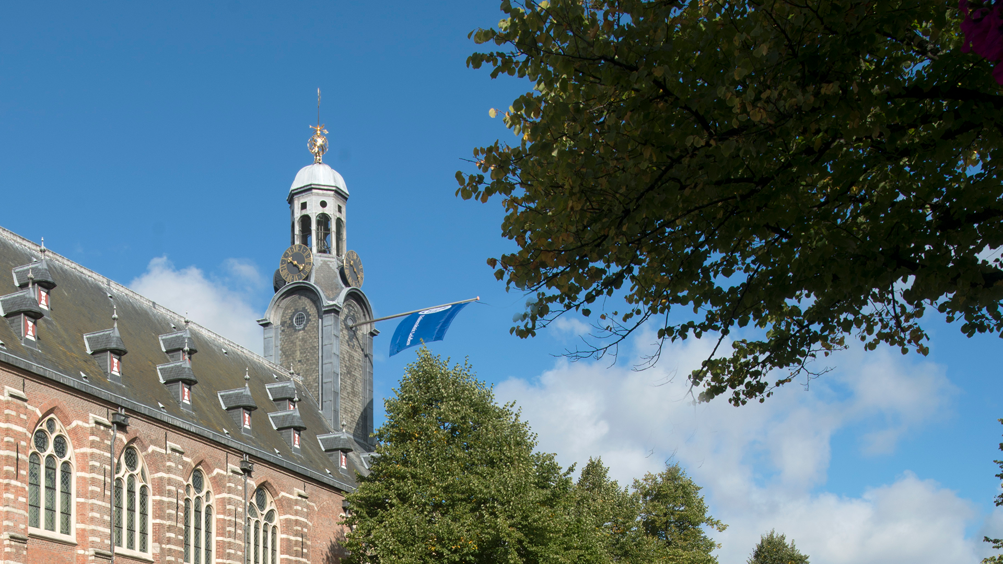
Strategy

Slide 13
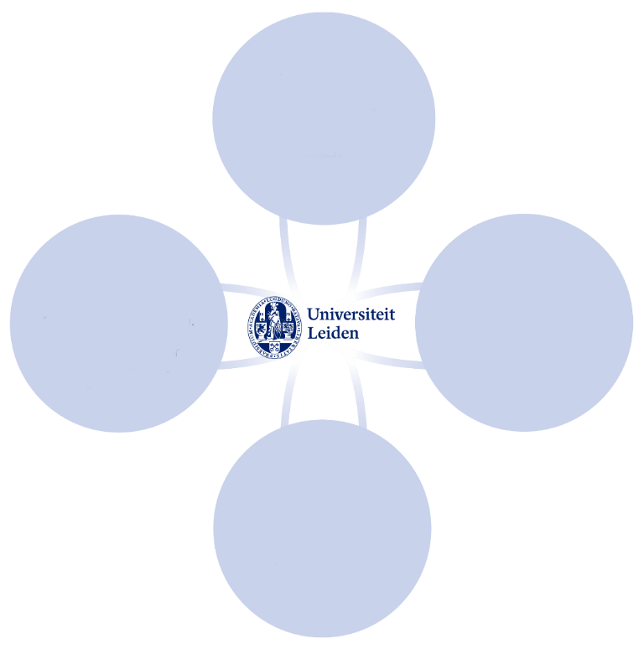
Innovating and Connecting
Strategic Plan 2022-2027
Room for innovation
Pioneering interdisciplinary research and teaching
Connecting
Future-proof student development
A healthy, involved and learning community
Innovative
Responsible
More value through strategic collaboration
Ample scope for talent and development
Free
Notes:
Strategic Plan 2022-2027. See strategischplan.universiteitleiden.nl/en
Innovative
Seeking new knowledge and understanding. Improving what can be improved. Shifting boundaries. Curious about one another and the unknown.
Connecting
Being part of a greater whole. Being successful together. Listening: to one another and to society. Actively contributing.
Free
Independent questioning. Offering scope for different perspectives and ideas, open discussion and curiosity-driven research.
Responsible
For promoting an inclusive community. For integrity in academic practice. For what we say and do, and how we interact with one another.

Slide 14
Ongoing strategic themes
Digitalisation
Sustainability
Diversity and inclusion
Internationalisation
Campus of the future
Notes:
Strategic Plan 2022-2027. See strategischplan.universiteitleiden.nl/en
Digitalisation
The pandemic shifted digital technologies from a support tool to an integral part of our research, teaching and work processes. We see technology as a way to achieve our ambitions. Our Digital Education Strategy and its implementation agenda will enable us to develop into a blended university where face-to-face interaction continues to be at the heart of our research and teaching.
Sustainability
Sustainability is high on our agenda. Our Sustainability Vision 2030 is the starting point for a new implementation programme with goals and activities for 2022-2026. At the heart of this vision is developing a more sustainable work and study environment that inspires and mobilises people both within and outside the university community to create a positive impact on society. With this in mind, we will further develop our existing sustainability initiatives to produce an integrated approach with visible effects on our research, teaching and organisation.
Diversity and inclusion
Leiden University stands for diversity and inclusion. We want to be an open community where everyone feels at home and has equal opportunities. An inclusive university community contributes to innovative and progressive academic teaching and research. Creating this community takes an integrated approach that inspires a culture change in our research, teaching, administration and leadership and makes diversity and inclusion an automatic part of our work and study. Our D&I policy is guided by our Diversity & Inclusion Work Plan.
Internationalisation
Academic knowledge does not stop at national borders. With our internationalisation strategy, we aim to strengthen our international position in research, teaching and organisation. Our university functions as a local hub for global challenges. We teach students from home and abroad to become global citizens and focus on issues close to home and far away. Our research and teaching draw on the knowledge and insights that emerge from the integration of national and international perspectives.
Campus of the future
Combining face-to-face and online teaching and learning creates opportunities for innovative education and flexibility. This makes it essential to consider user needs when designing working and learning spaces. Interdisciplinary initiatives, such as the Social Sciences & Humanities (SSH) labs, together with shared facilities such as advanced video-recording studios, foster interaction and reinforce links between research and teaching. Our Campus of the Future programme brings together campus development, new working practices, blended learning and shared research facilities to support this.

Slide 15
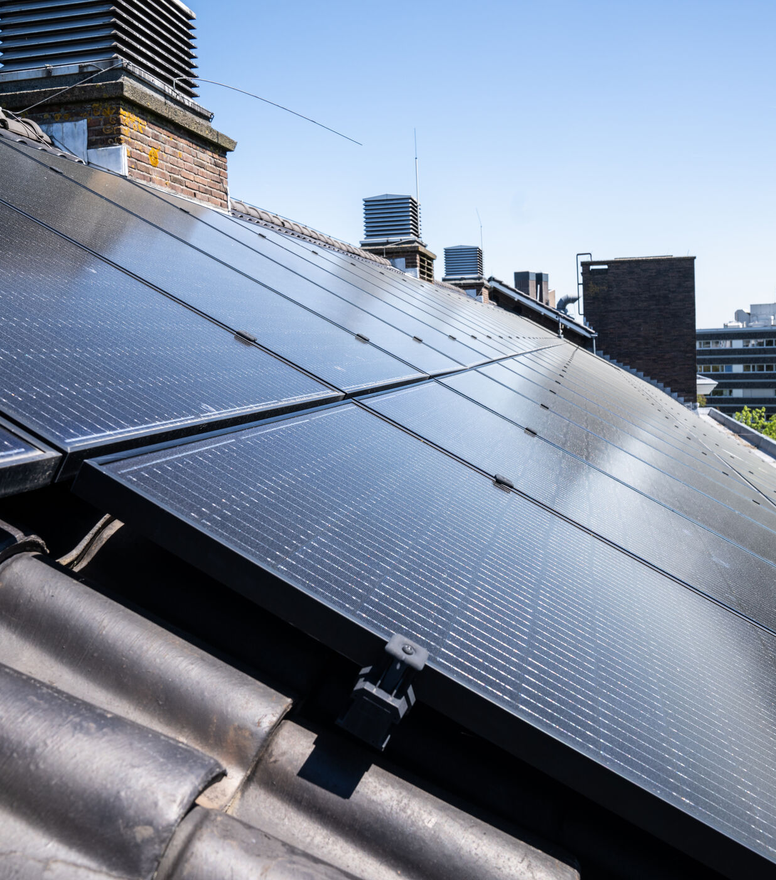
Sustainability
Sustainability Vision 2030
Sustainability in our research and teaching
Awareness and engagement
Climate-neutral by 2050
Circularity
Sustainable environment
Notes:
Sustainability is an integral part of our strategy.
Through our Sustainability Vision 2030, we aim to integrate sustainability into our research, teaching and operations. In our research and teaching, we actively focus on developing solutions for societal transitions, while students are educated to become critical and responsible professionals.
Awareness and engagement are central to this, and through initiatives such as Leiden University Green Office (LUGO) and Leiden Environmental Action Framework (LEAF), students and staff are encouraged to support sustainable choices and innovation, both grassroots and institutional.
We are working to create a sustainable campus with a clear route map to becoming climate neutral by 2050. The focus is on:
energy transition
circular principles in our buildings and processes
continuing to create a healthy and sustainable environment for students and staff
We are building a future-proof academic community that aligns with Leiden’s societal responsibility.
https://www.universiteitleiden.nl/en/dossiers/the-sustainable-university

Slide 16
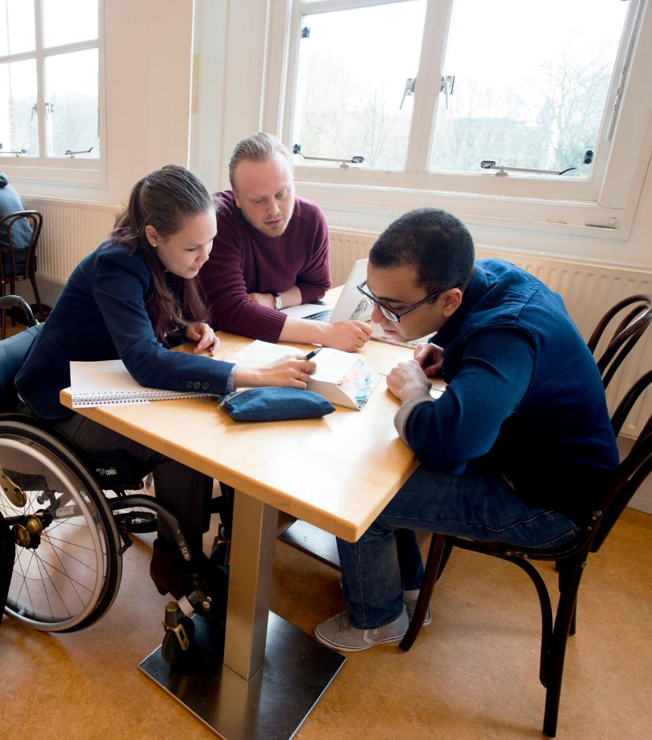
Diversity and inclusion
Diversity and inclusion are essential to high-quality research and teaching
Every student, staff member and visitor should feel welcome and valued
Policy, HR and connection with networks
Events and annual symposium
Notes:
Diversity and inclusion are fundamental to our core values. We are committed to creating a university where everyone is welcome and feels valued, regardless of background, sex, gender identity, sexual orientation, age, religion, cultural or socioeconomic background or disability.
Our policy focuses on the recruitment and progression of students and staff from diverse backgrounds. This includes raising awareness of unconscious bias in hiring processes. We also aim for greater gender balance in academic roles.
A further focus is on creating accessible buildings with the right facilities for all our students and staff, such as gender-neutral toilets, milk expression rooms and quiet and prayer spaces. Additional attention and support are available to students who need this, including students with a disability and international and first-generation students. We are committed to creating an inclusive community that ensures all students and staff feel valued and respected and have the opportunity to develop to the full.
The university and faculties organise various events and meetings, including the annual Diversity Symposium. It also offers workshops and training on unconscious bias and inclusive leadership for managers and selection committees, as well as programmes to help underrepresented groups improve their career prospects.

Slide 17
Research

Slide 18
Research in figures
6,245
Publication
557
PhD defences
29
Spinoza Prizes
Until now
97
NWO Grants
15
ERC Grants
339
Professors
36% female
Notes:
Figures are from Leiden University’s annual report 2024
Curiosity-driven research – fundamental research in particular – is of great importance to Leiden University. Quality and excellence are guiding principles here. Our researchers are given the resources and space they need to excel. The number of highly cited researchers from Leiden per year is relatively high and above the global average.
Spinoza Prizes
Leiden University is in the lead: we have won 28 of the 111 Spinoza Prizes, the highest accolade in Dutch science, which is awarded by NWO.
(https://www.universiteitleiden.nl/en/academic-staff/leiden-spinoza-prize-laureates)
Distribution of ERC Grants
Synergy 1
Proof of Concept 5
Advanced 4
Consolidator 2
Starting 3
Distribution of NWO-vernieuwingsimpuls grants
Veni 18
Vidi 14
Vici 4

Slide 19
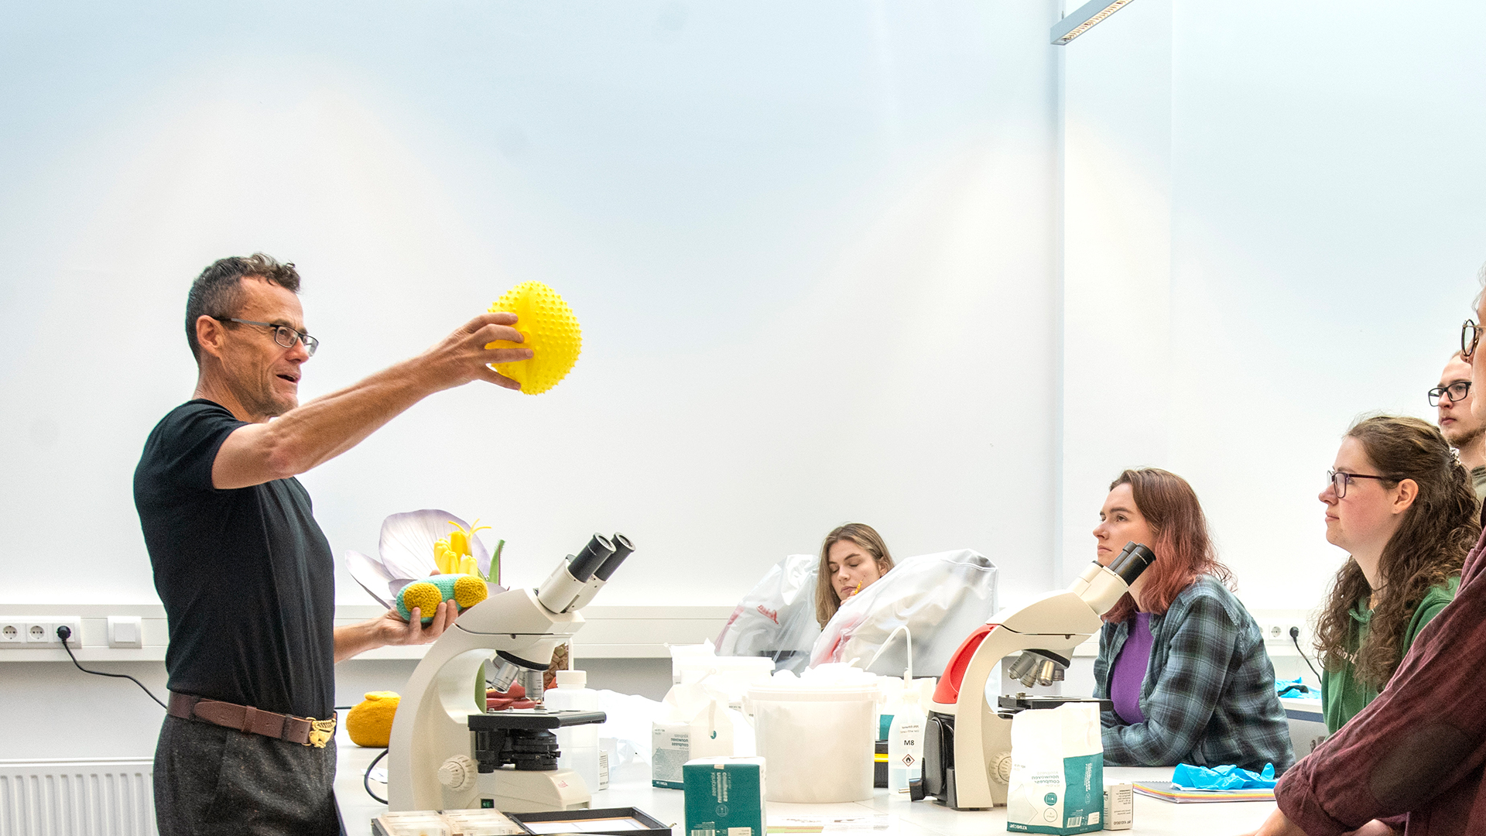
Teaching
Notes:
Mono-, multi- and interdisciplinary programmes
We offer a wide range of mono-, multi- and interdisciplinary programmes. Our minors allow students to develop a multidisciplinary profile. Many of our new programmes are interdisciplinary.
International
The majority of our master’s programmes are English taught. We have 16 English-taught bachelor’s programmes (including Psychology, Archaeology, Liberal Arts and Sciences, International Studies).
Teaching staff
We value inspiring teaching staff who involve students in their research. We support innovative teachers through initiatives such as the Leiden Teachers Academy, a think tank where teachers exchange innovative teaching experiences.
https://www.universiteitleiden.nl/onderwijs
https://www.universiteitleiden.nl/jaarverslag

Slide 20
Teaching in figures
33,500
Students
10,000
Graduates per year
51
Bachelor’s programmes
83
Master’s programmes
22%
International students
100+
Programmes for professionals
Notes:
Figures are from Leiden University’s annual report 2025
Exact number of students: 33,494

Slide 21
Learning@LeidenUniversity
Integrating research and teaching
Cultivating academic professionals and engaged citizens
Developing skills
Engaging with society
Enhancing employability
Activating teaching and learning with flexible learning pathways​
Creating a diverse, international university community​
Notes:
Students develop into academic professionals and engaged citizens who can help find solutions to society’s challenges. Our teaching is activating. We develop flexible learning pathways and use digital learning tools and methods if they are beneficial.

Slide 22
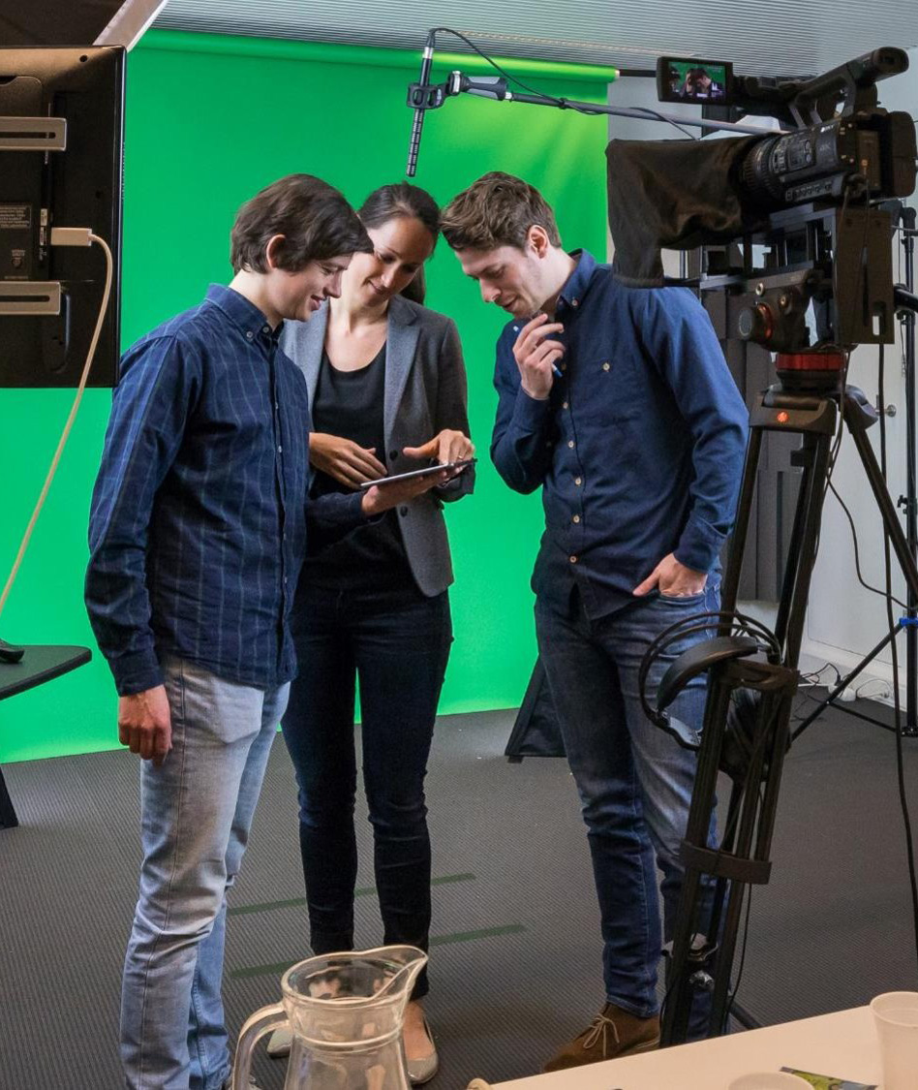
Innovative teaching
Leiden Learning and Innovation Center (LLINC)​
Leiden Teachers’ Academy​
Grassfield grants
Leiden University Academy
Notes:
Leiden Teachers’ Academy fosters innovation and provides excellent teachers with the room and funds needed for innovation. LUS Teaching Prize winners automatically become members of the LTA.
universiteitleiden.nl/dossiers/lta
The Grassfield grant is an annual funding scheme for upscaling educational innovations.
In terms of lifelong learning, Leiden University Academy offers a wide range of courses for professionals.

Slide 23
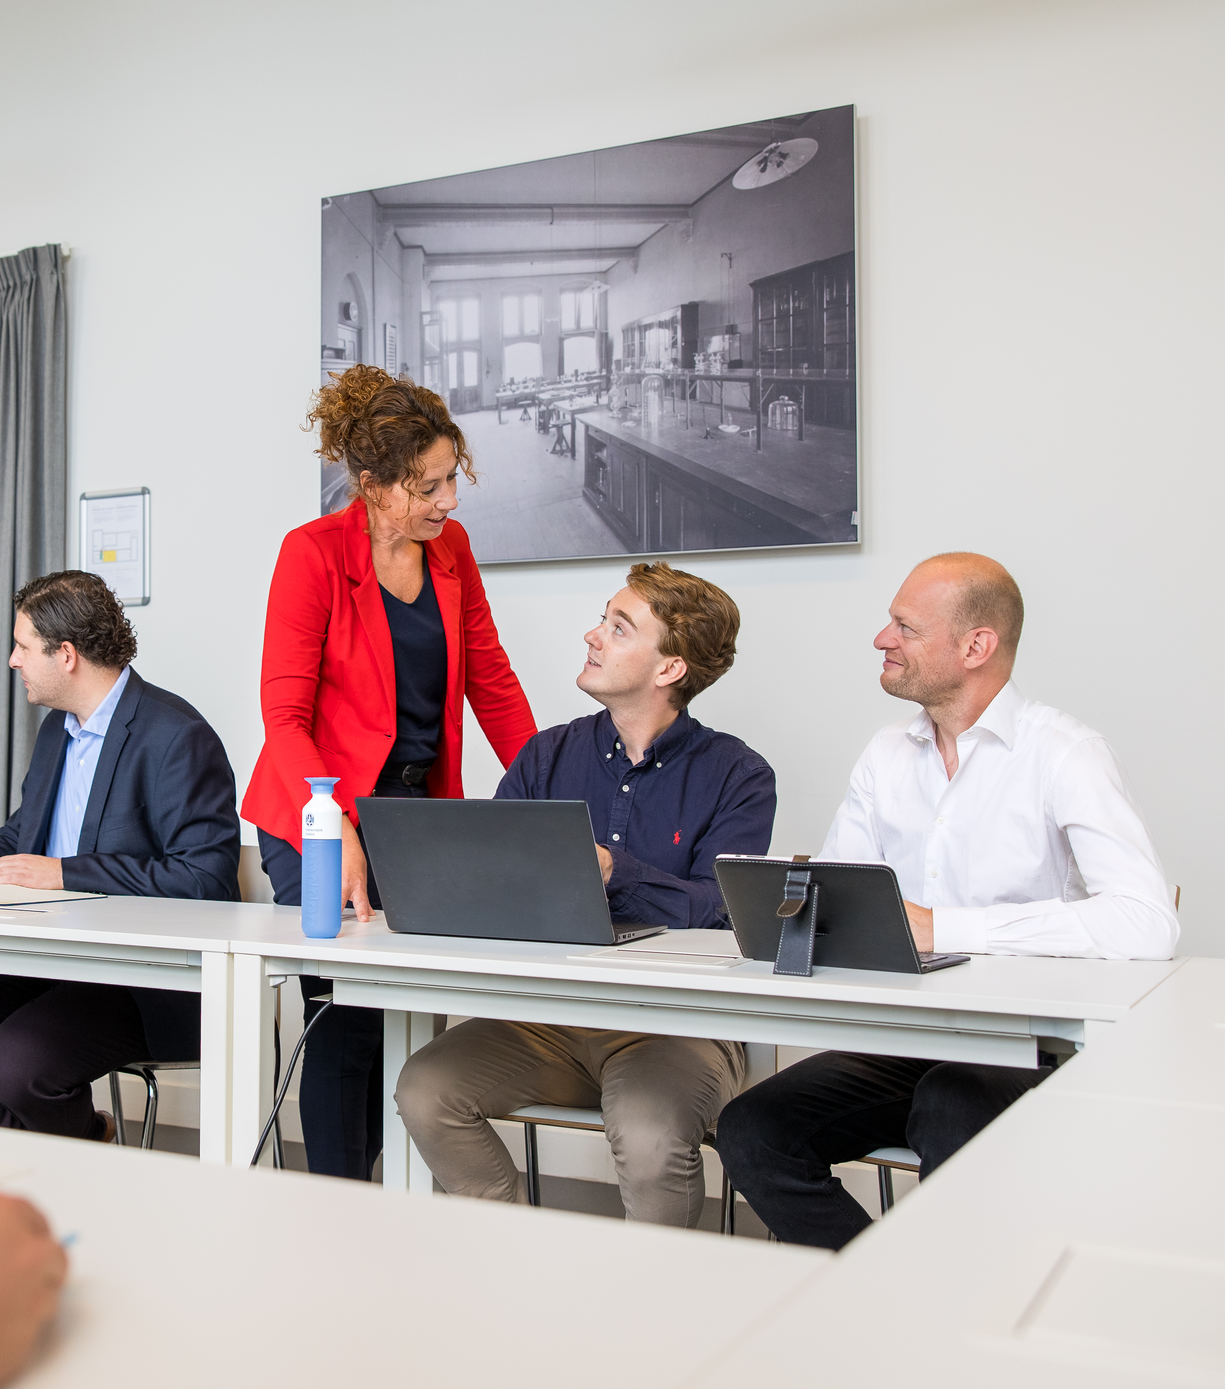
Lifelong learning
Professional education
Flexible learning
Courses for refugees
Study abroad
Summer schools
Notes:
We offer opportunities for adult learners, ranging from short courses for those looking to explore new ideas to longer programmes for those seeking to further their careers. From a one-off evening lecture and a course of a few months to a part-time programme spanning several years, there are many different ways to study at Leiden University.
https://www.universiteitleiden.nl/en/education/other-modes-of-study
https://www.universiteitleiden.nl/en/education/education-for-professionals
https://www.universiteitleiden.nl/en/education/other-modes-of-study/education-for-refugees

Slide 24
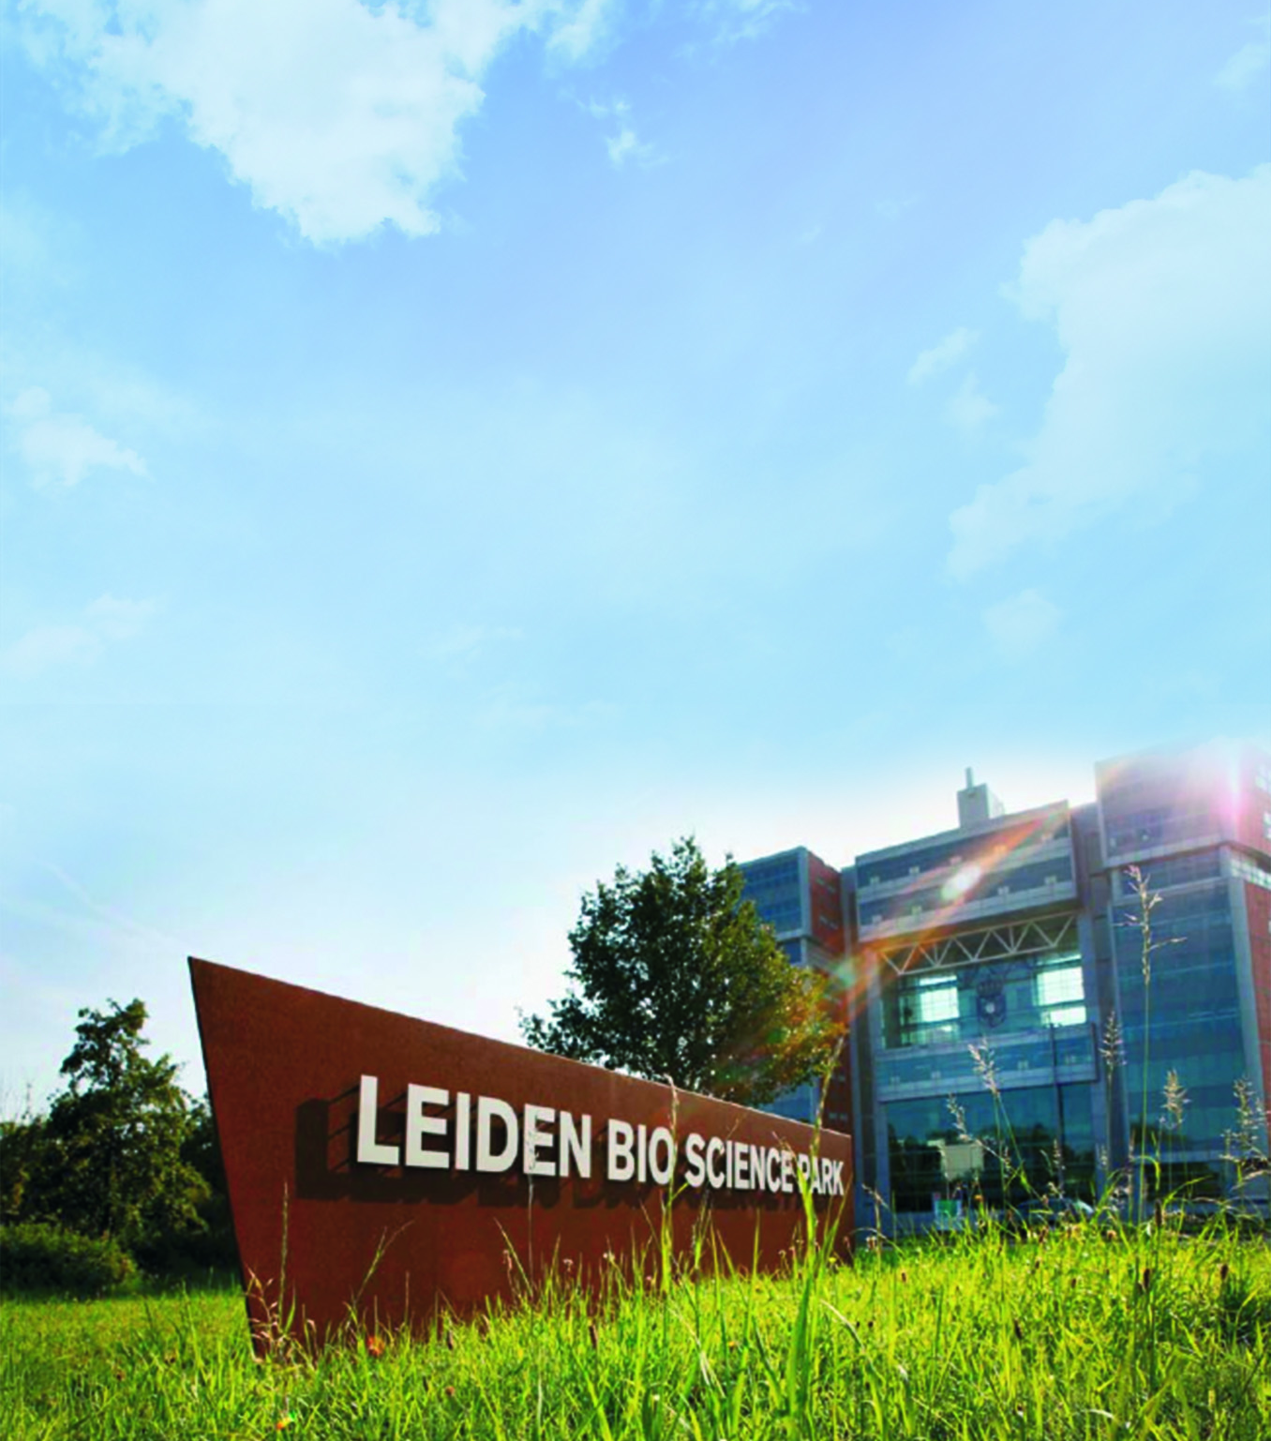
Leiden Bio Science Park
Largest life science & health cluster in the Netherlands
519 organisations and companies
27,000 students
26,000 staff
86 spin-offs
92 start-ups
Notes:
Leiden Bio Science Park
The university works together with the LUMC, industry and the Municipality of Leiden at the Leiden Bio Science Park (LBSP). Many of the businesses and scientists at the LBSP work on drug development. Leiden alumni often find jobs at the LBSP, and the founders and CEOs of several businesses there studied or received their PhD at the university.
The LBSP is the main life science & health cluster in the Netherlands (and among the top 5 in Europe) and is one of eight ‘top-science’ parks in the Netherlands (others include DSM Chemie and Wageningen Food).
The LBSP drives innovation by focusing on the areas that matter most to the future of health. These are:
advanced gene therapies and regenerative medicine
viral and infectious diseases
diagnostics and technological innovation
prevention and lifestyle
data & AI (as a cross-cutting theme)
https://www.universiteitleiden.nl/en/collaboration/partnerships

Slide 25
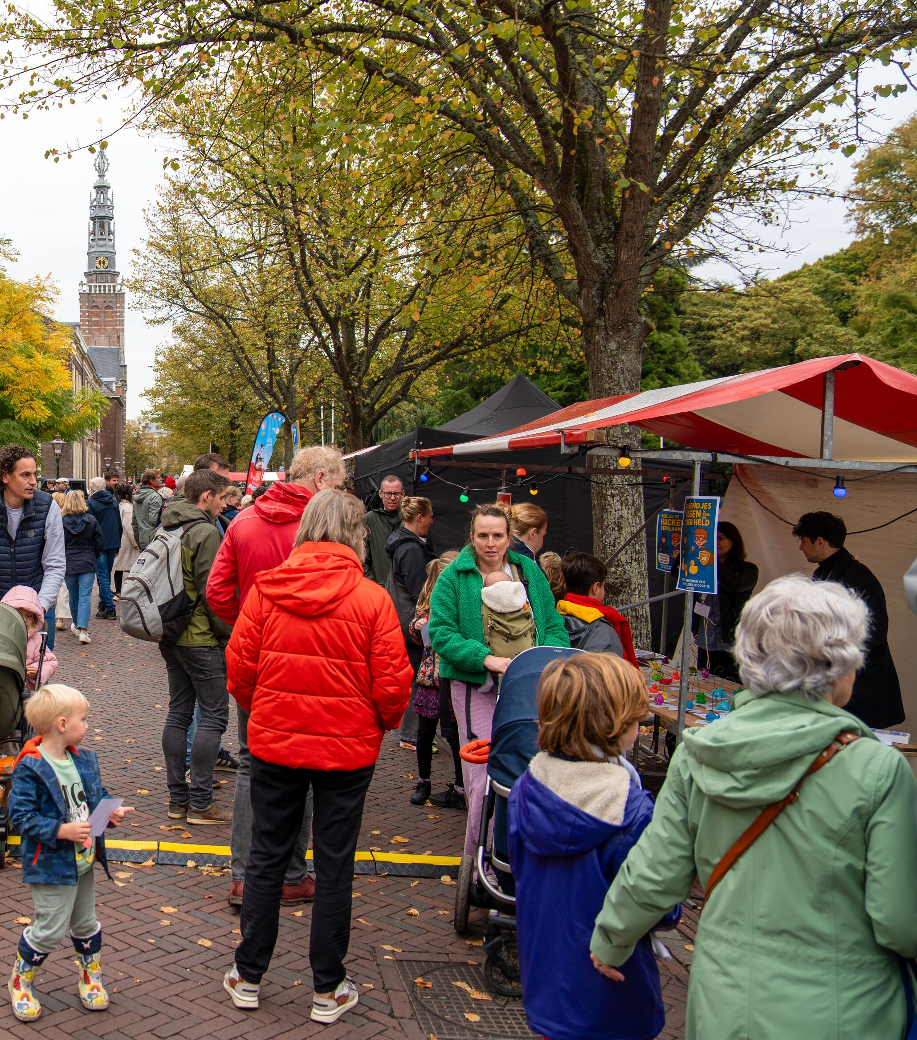
Leiden City of Knowledge
Collaboration across 3 main themes:
Health and well-being
Biodiversity and sustainability
Cultural heritage
Notes:
In 2017, Leiden University, Leiden University Medical Centre (LUMC), University of Applied Sciences Leiden and the Municipality of Leiden agreed to work together more closely over four years to give further impetus to the development of Leiden Kennisstad (‘Leiden City of Knowledge’). Following an evaluation of the project, the recommendation was to continue the collaboration, based on these three themes:
Health and well-being
Biodiversity and sustainability
Cultural heritage.
With these three themes, we are building on the city’s existing strengths and addressing the major social challenges that lie ahead and are being tackled at both national and international levels. The themes must be viewed in conjunction with one another so that they reinforce each other.

Slide 26

Leiden-Delft-Erasmus
Universities

Slide 27
3 universities
Leiden University
Delft University of Technology
Erasmus University Rotterdam
5 themes
Sustainable Futures
Urban Transformations
Technology, Science and Society
Healthy Society
Global Engagement
Leiden
University
TU Delft
Erasmus University
Rotterdam
Notes:
Since 2012, Leiden University, Delft University of Technology (TU Delft) and Erasmus University Rotterdam have collaborated through the Leiden-Delft-Erasmus (LDE) Universities strategic alliance to advance interdisciplinary and transdisciplinary research, education and operations.

Slide 28
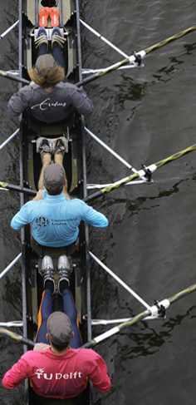
Collaboration
Research
LDE progammes
LDE Centres
Medical Delta
Teaching
Joint bachelor’s and master’s programmes
Minors
Postgraduate education
Operations
Promoting staff mobility
Traineeships
Teacher professionalisation
Notes:
The Leiden-Delft-Erasmus inspires new initiatives between researchers from different disciplines. Initially developed as programmes, some of these multidisciplinary collaborations go on to be centres. The current LDE programmes are:
RESEARCH
LDE programmes
Climate and Biodiversity
Global Heritage and Development
Healthy Society
LDE Global: Research and Education with the Majority World
Leiden-Delft-Erasmus-East Africa Research Network - LEARN
LDE Indonesia Centre
LDE Centres
Centre for BOLD Cities
Centre Governance of Migration and Diversity
Centre for Port Cities Futures
Centre for Sustainability
International Centre for Frugal Innovation
https://www.leiden-delft-erasmus.nl/en/lde-centres-en-programmes
Medical Delta
Medical Delta is an LDE partner and was founded in 2006 by the three universities (Delft University of Technology, Leiden University and Erasmus University Rotterdam) and the two university medical centres (LUMC and Erasmus MC) in the province of Zuid-Holland.
Since 2018, four universities of applied sciences in the province have also been part of the alliance (The Hague University of Applied Sciences, InHolland University of Applied Sciences, Rotterdam University of Applied Sciences and Leiden University of Applied Sciences).
Multidisciplinary collaboration among clinicians and technologists is a feature of Medical Delta research programmes. Thanks to the input from universities of applied sciences, the business community, healthcare institutions and public authorities, and through Living Labs, these programmes all have a significant impact on people, healthcare, knowledge development and the region.
https://www.leiden-delft-erasmus.nl/en/centres/medical-delta
TEACHING
Joint programmes
Bachelor’s and master’s programmes
The three universities have a joint education portfolio comprising joint bachelor’s and master’s programmes (joint degree programmes) and master’s tracks. Through these interdisciplinary and multidisciplinary programmes, LDE helps address societal challenges and responds to student demand. The proximity of the three university towns makes it easy for students to attend these programmes in person.
https://www.leiden-delft-erasmus.nl/en/education/bachelors-degree-programmes
https://www.leiden-delft-erasmus.nl/en/education/masters-programmes-and-tracks
Minors and honours classes
The universities offer joint, multidisciplinary minors and honours classes on socially relevant topics. Students from different degree programmes and universities work together on social issues. Students also have access to the minors offered by the partner universities that help them broaden their learning.
https://www.leiden-delft-erasmus.nl/en/education/minors
Postgraduate education
The three universities are working with other partners to develop postgraduate education programmes for professional audiences. One example is the Executive Master’s in Customs and Supply Chain Compliance.

Slide 29
LDE partners
Government, industry and civil society organisations
Alliance partner: Medical Delta
Strategic partner: LUMC
Notes:
LDE works with a wide range of organisations in different ways. These organisations can be involved in partnerships, for example, or serve on the advisory boards of LDE centres. Others, such as government or industry, provide cases for students to study. Some of these partnerships go back years.
https://www.leiden-delft-erasmus.nl/nl/over-ons/samenwerkingen
Alliance partner: Medical Delta
LDE partner Medical Delta bridges the gap between healthcare and technology. By bringing together their expertise, the universities and university medical centres ensure that innovative medical solutions are found. They work together on scientific breakthroughs and technological advances for the region, building a healthy future and sustainable healthcare for all patients.
Strategic partner: LUMC
The Leiden University Medical Center (LUMC) is a linchpin in the LDE alliance. As the medical heart of this alliance, LUMC bridges the gap between fundamental research, clinical practice and technological innovation. One example of this synergy is its active role in Medical Delta, which brings together the LUMC’s medical expertise with the technological impact of TU Delft and the socio-economic insights of Erasmus University. By bringing disciplines together, the LUMC contributes directly to a healthy society within LDE, addressing complex health issues in society and strengthening the position of Zuid-Holland as a leading international knowledge region.

Slide 30

Internationalisation

Slide 31
Vision on internationalisation
Innovative and future-proof education portfolio
Interdisciplinary research with local and global impact
Global positioning and visibility
Promoting academic freedom and democracy
Notes:
universiteitleiden.nl/en/about-us/profile/internationalisation/vision-and-strategy

Slide 32

International collaboration
Focus on
Northeast and Southeast Asia
Latin America
Africa
Europe
Partnerships with
Academic partners
Non-academic partners
Notes:
Leiden University has always had partners across the world, with a particular focus on Europe, Asia, Africa and Latin America.
A global network of more than 600 universities and partners encourages our students to do part of their degree programme abroad.
Academic alliances foster research collaboration, student exchanges and talent development.
Non-academic partners include ministries and research councils
Alliances:
League of European Research Universities
Una Europa
Het Europaeum
European University Association
Euroscholars
Coimbra Group
Erasmus Mundus
International Association of Universities
(https://www.universiteitleiden.nl/over-ons/samenwerking/samenwerkingsverbanden/internationaal)

Slide 33
European networks
League of European Research Universities
Promoting excellence in European research and teaching
Una Europa
Collaborating for innovation in European research and teaching
Notes:
Two networks of top research universities.
The League of European Research Universities (LERU) was founded in 2002 to promote groundbreaking fundamental research, excellent teaching and policy advocacy within Europe, often with a focus on open science and innovation.
Una Europa is an alliance of 11 top European research universities working together on the ‘University of the Future’. Founded in 2019, the partnership promotes intensive international mobility, joint teaching and research, and innovation for students and staff.
Both networks seek to connect with the rest of the world. For example, Una Europa collaborates with partners in Africa, while LERU is a member of the Global Research-Intensive Universities Network (GRIUN).

Slide 34
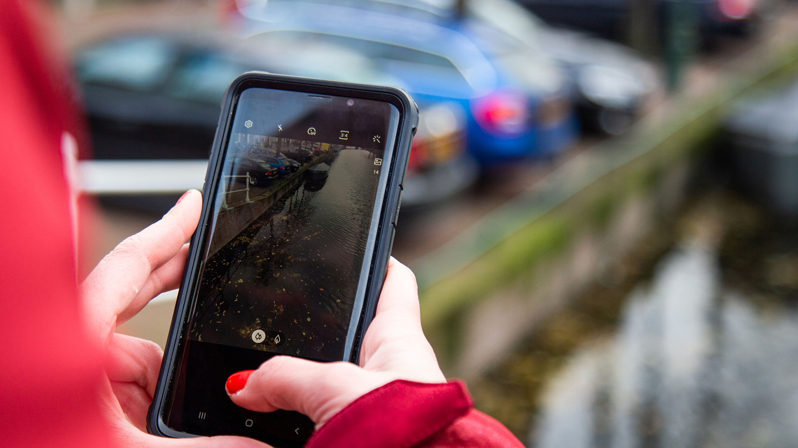
Impact

Slide 35
Impact
Societal
Academic
Economic
Notes:
Our research and teaching have an impact on society. One way we make this impact is by working with partners at the local, regional, national and international levels.
Numerous start-ups are supported by Luris research impact centre and PLNT innovation hub each year. PLNT hosted more than 70 organisations in 2024, ranging from student businesses to innovative spin-offs.
Economic impact: In 2017, Leiden University and the LUMC were responsible for over 50,000 jobs in Europe and more than €4 billion in gross value added in Europe.
Societal impact: researchers contribute to policy and offer expert commentary in the media on current affairs.
Collaboration with partners: our research leads to patents and contributes to solutions to societal issues. To achieve this, we work with the public sector and industry, for instance Leiden Bio Science Park.
https://www.universiteitleiden.nl/en/about-us/impact

Slide 36
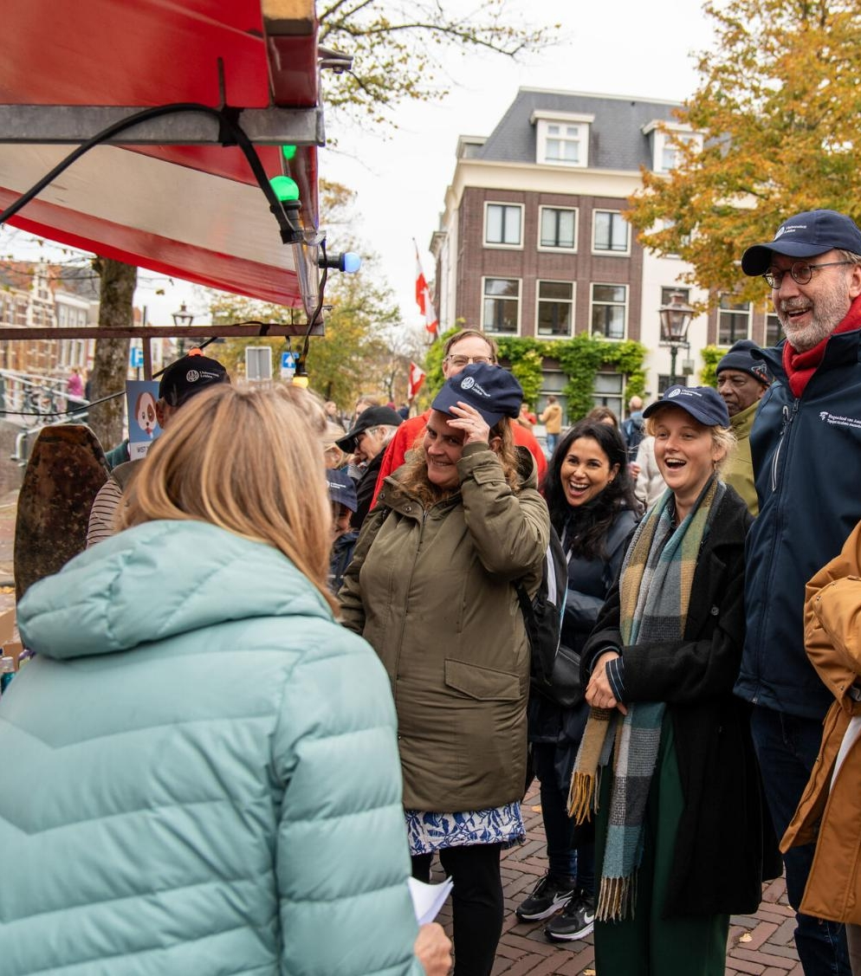
Innovation and knowledge transfer
Innovating with local, regional, national and international partners
Sharing knowledge to help solve the challenges of our time
Making science accessible to the general public
Notes:
Examples of partners
LOCAL
Leiden Bio Science Park
BioPartner Center Leiden
LeidenGlobal
Lorentz Center
Leiden City of Knowledge
Leiden Instrument Makers School
Leiden University of Applied Sciences
MBO Rijnland
REGIONAL
Leiden-Delft-Erasmus Universities
Collaboration with institutions in The Hague
Key Region Leiden
Medical Delta
NATIONAL
Universities of the Netherlands
INTERNATIONAL
League of European Research Universities
Una Europa
We work with many different partners at the local, regional and international level. We collaborate closely with the Leiden University Medical Center (LUMC) in our research and teaching (through our professors and medicine programme), and are one of the partners in Medical Delta, the Zuid-Holland alliance of universities, industry and government working in the life sciences and medical technology.
Luris connects researchers from the university and the LUMC with the market, and the municipalities of Leiden and The Hague help us develop our activities in the two cities.
In Leiden our researchers work with specialised businesses at the LBSP on discoveries and products in the life sciences.
In LDE, we work with Erasmus University and Delft University of Technology on joint research and teaching.
We are a member of LERU along with 23 other European research universities.
We offer joint programmes and research options together with the Royal Conservatoire and the Royal Academy of Art in The Hague.
And there are plenty more examples of collaboration: with the LUF, for example, our alumni fund.
Our research and teaching have an impact on society in various ways: we advance knowledge, we provide highly skilled graduates and our alumni make a difference to society. We work with the profession (many of our professors are active in their field outside the university), we carry out research for ministries and civil society organisations, we work with industry, for example at the LBSP.
Our accessible science reaches a wide audience: at Lowlands, during pop-up lectures or science cafés in The Hague, the Night of Discoveries, 3 October University, the Science Market on 3 October, Leiden Museum Night and with popular science books and appearances in the media.
We have an academic and professional impact, on the commercial and the government sectors. Our knowledge reaches a wide audience and our alumni are committed to society and education.
(https://www.universiteitleiden.nl/over-ons/impact)
https://www.universiteitleiden.nl/jaarverslag

Slide 37
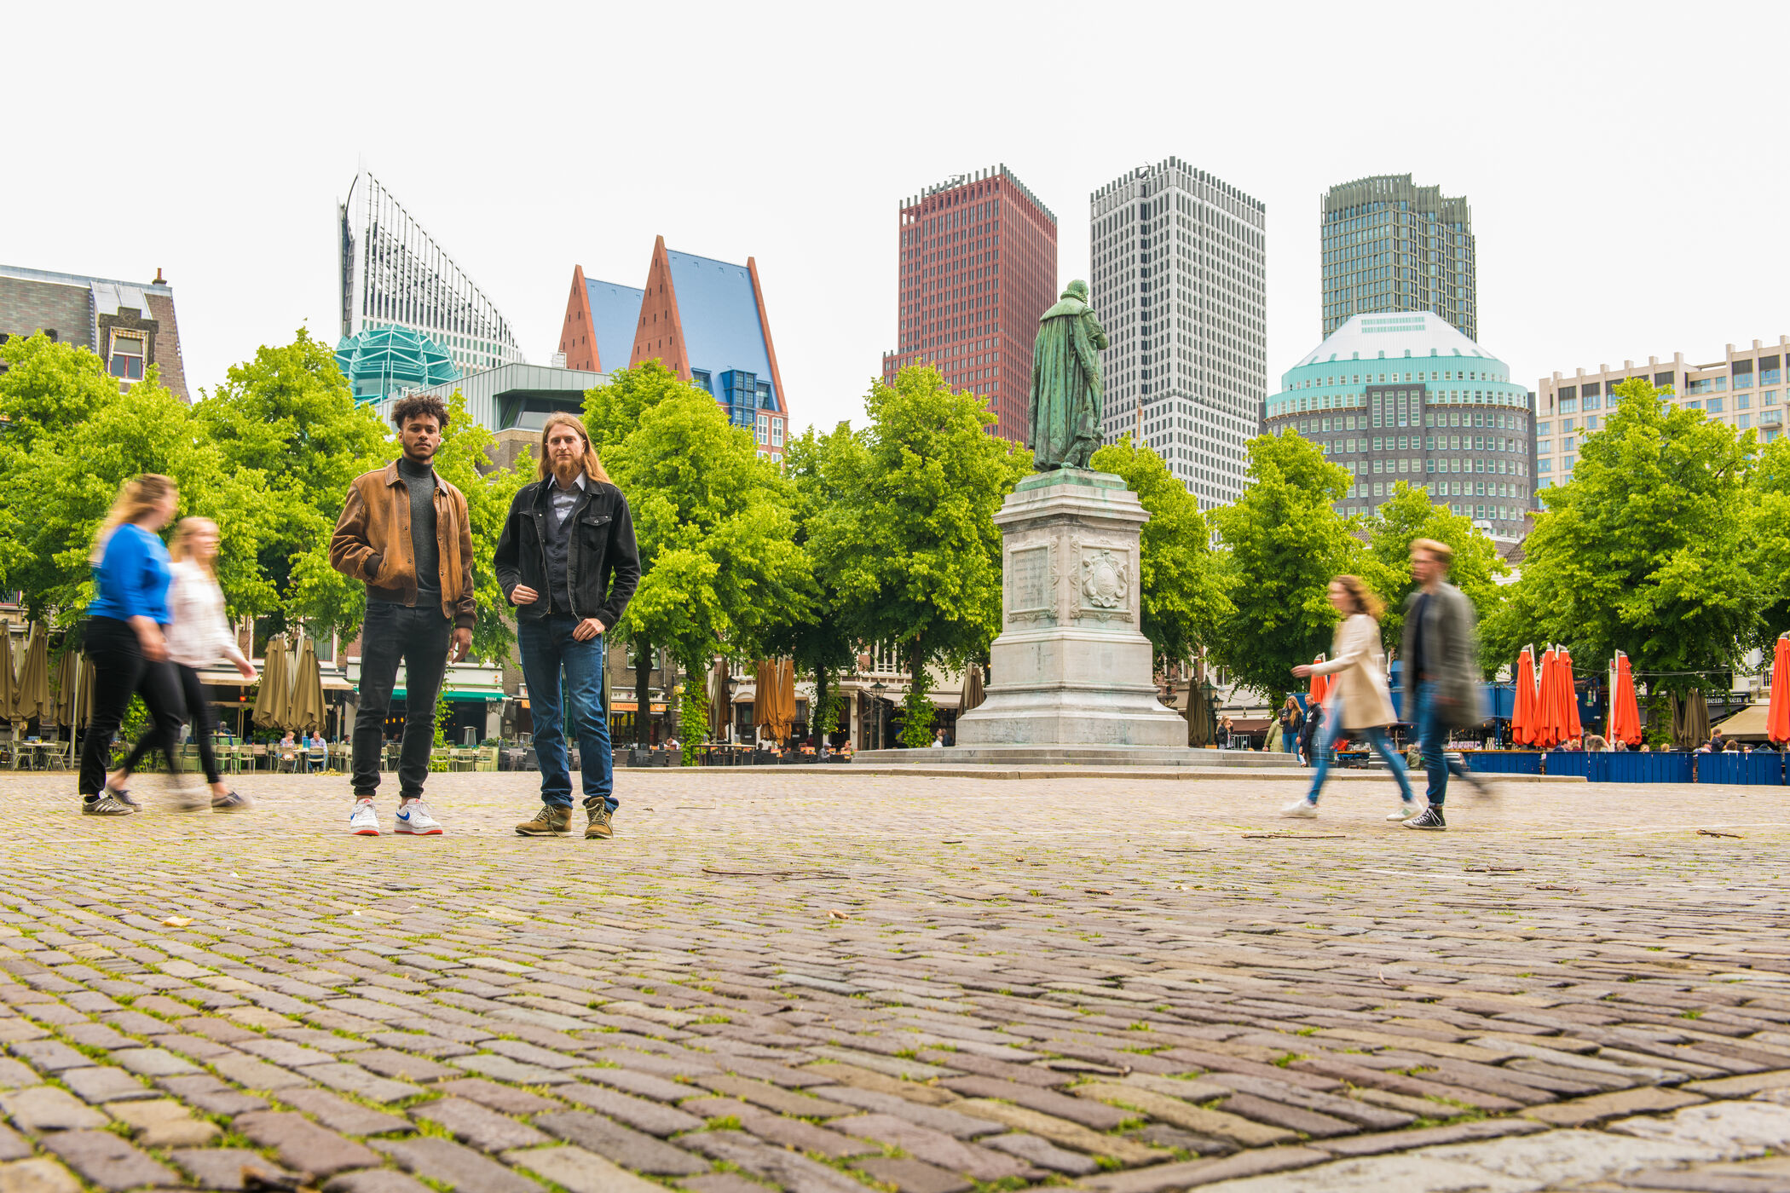
Leiden University in The Hague

Slide 38
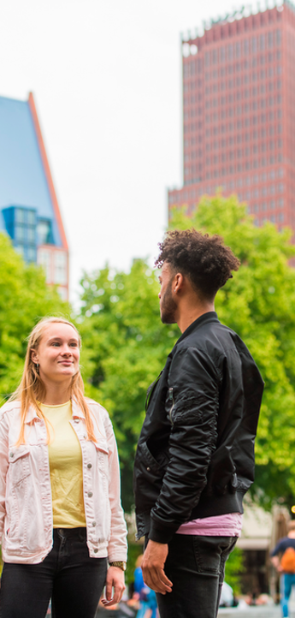
Campus The Hague in figures
7,000
Students
103
Nationalities
22
Programmes
4
Locations
700+
Employees
7
Faculties
Notes:
These figures are from Leiden University’s annual report 2025
Since 1999, Leiden University has been a university in two cities: Leiden and The Hague. With a young and vibrant campus where research and education develop rapidly. Close to politics, justice and government. We work closely with various partners in business, education and social organisations.
Campus The Hague offers 9 Bachelor’s programmes, 10 Master’s programmes and 3 post-initial programmes.

Slide 39
Campus The Hague Strategy 2020-2030
Leiden University permanent presence in two cities
Teaching and research linked to The Hague
Special focus on the city’s children
Close relationship with the city and partners

Slide 40
Key themes in The Hague
International peace, law and security
Globalisation and international relations
Politics, public administration and public finance
Urban issues
Health and patient care

Slide 41
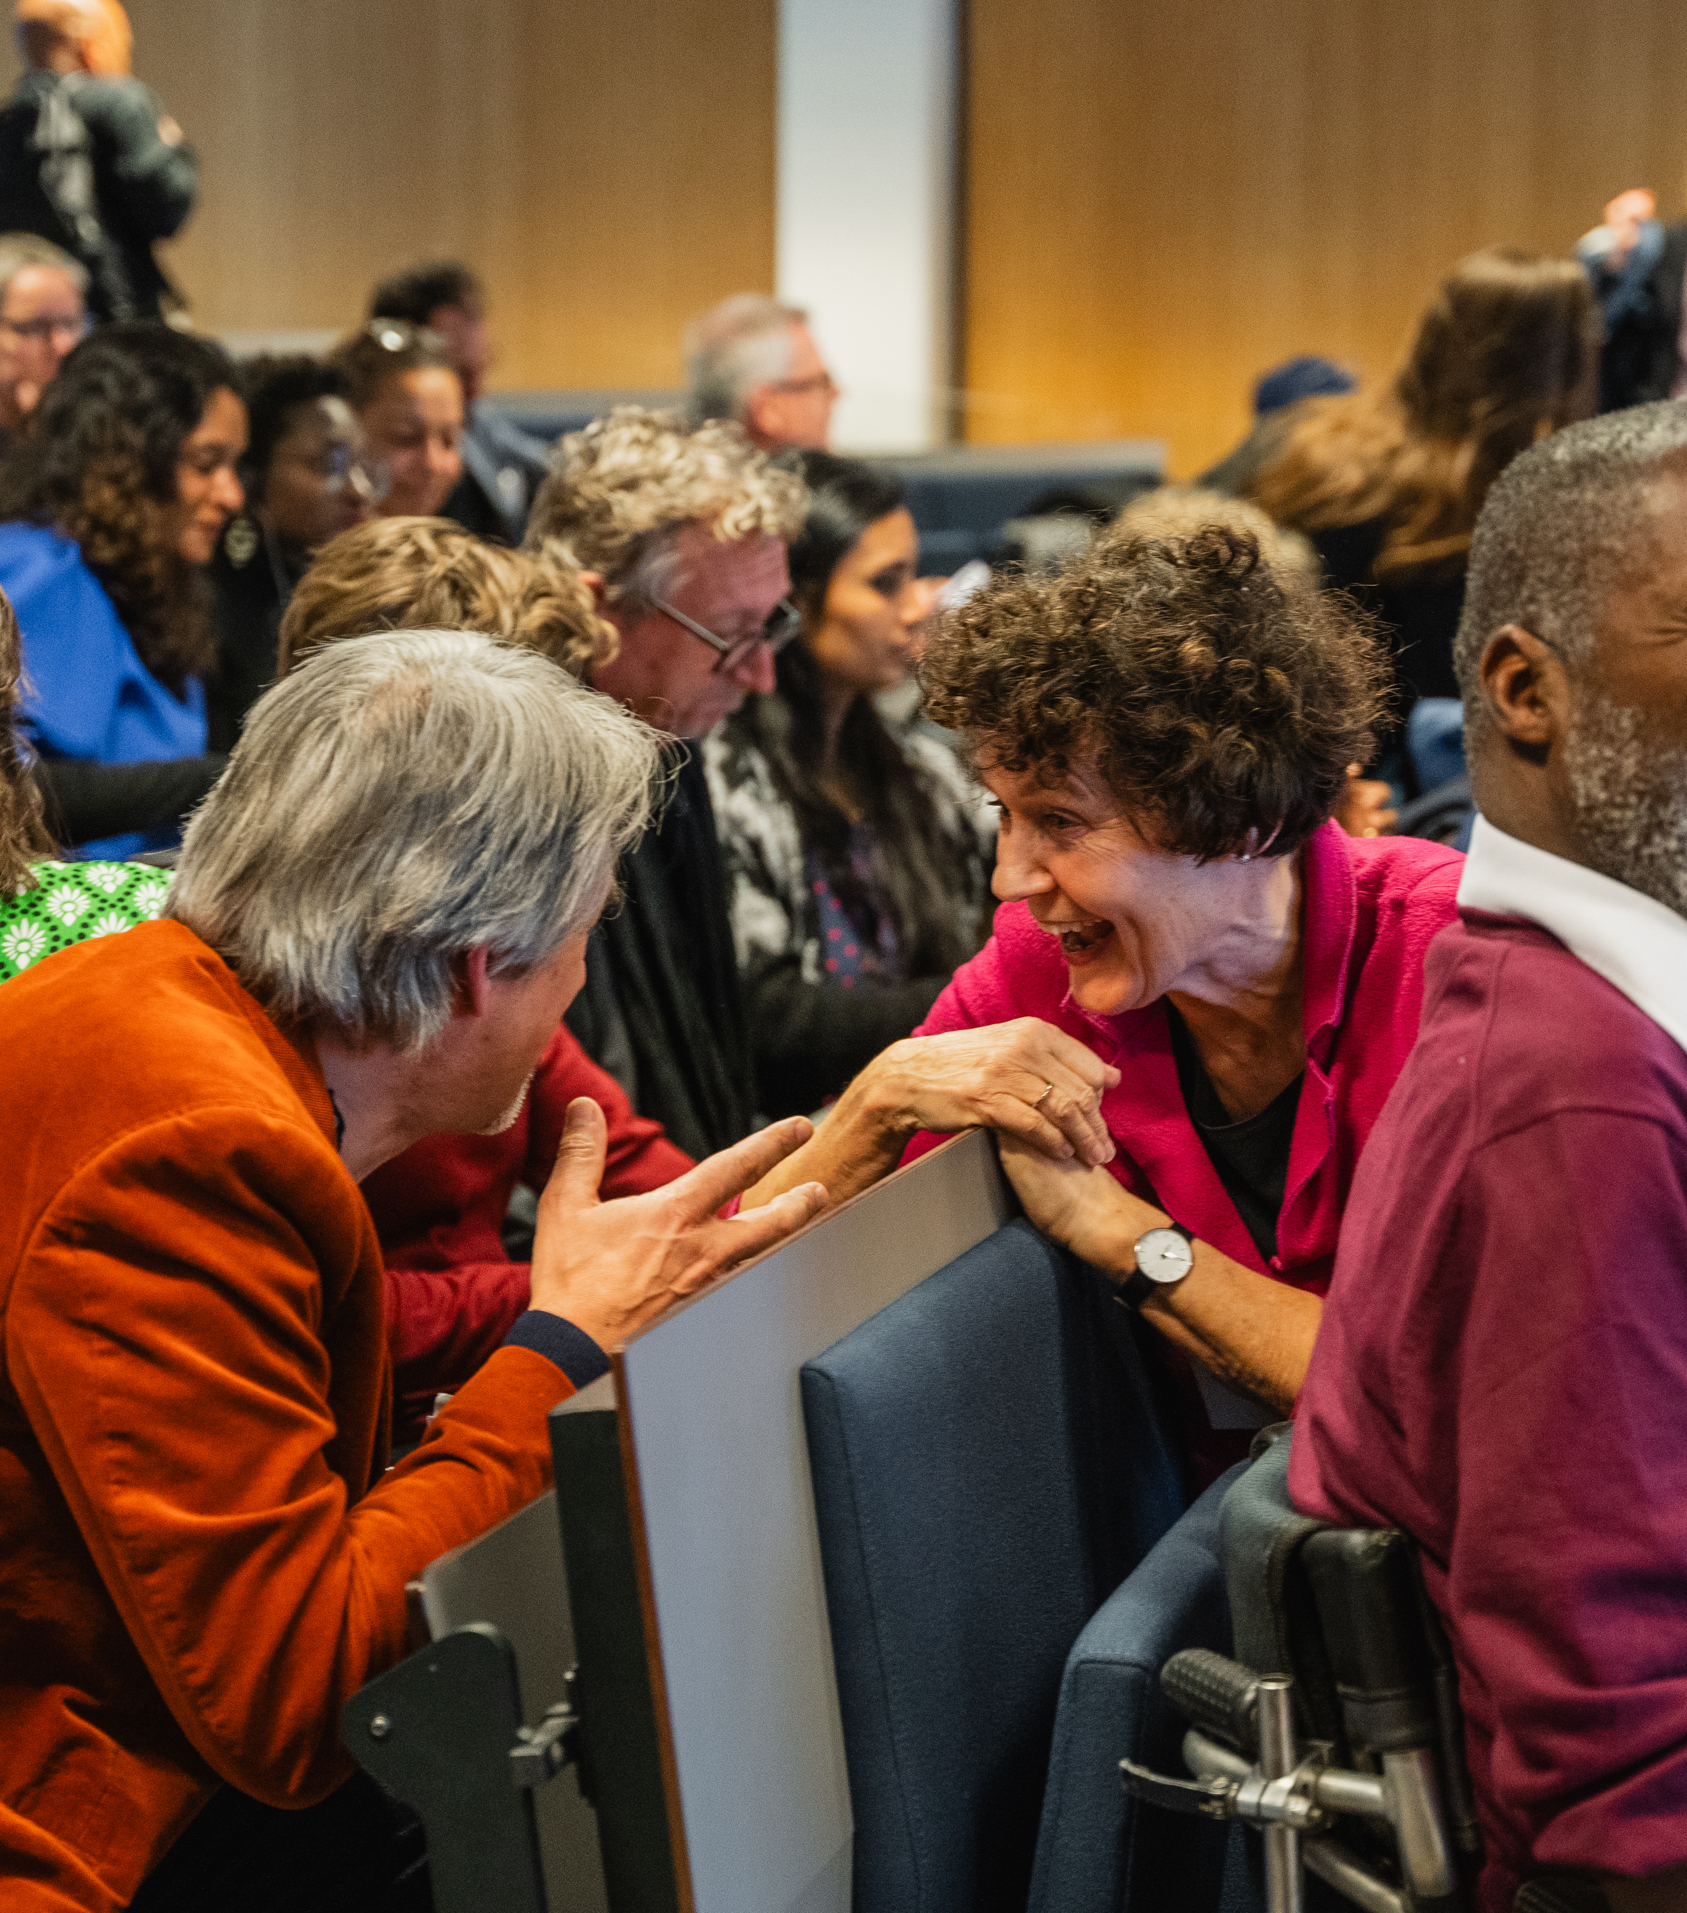
Teaching in The Hague
Bachelor’s and master’s programmes
Leiden University College The Hague
Education for professionals
Summer schools
MOOCs
Notes:
Our teaching in The Hague is rooted in our research. Alongside bachelor’s and master’s programmes, we provide development options to school students, professionals and anyone else with an interest.
We hope to expand our teaching in The Hague in the coming years.
Leiden University College The Hague
Leiden University College The Hague (LUC) is our international honours college in The Hague offering talented and motivated students from all around the world an innovative liberal arts and sciences bachelor’s programme.
Professional education
We have a growing range of opportunities for professionals, from short courses to part-time programmes. Lifelong learning will be an even greater focus in the coming years.
Summer schools
Campus The Hague offers a wide range of English-taught summer schools: for example, Frontiers of Children’s Rights or Preventing Violent Extremism.
MOOCs from The Hague
Innovative forms of online learning, such as Massive Open Online Courses (MOOCs), are very successful in reaching new audiences across the world. The Hague also offers some of these courses.
https://www.universiteitleiden.nl/en/the-hague/teaching

Slide 42
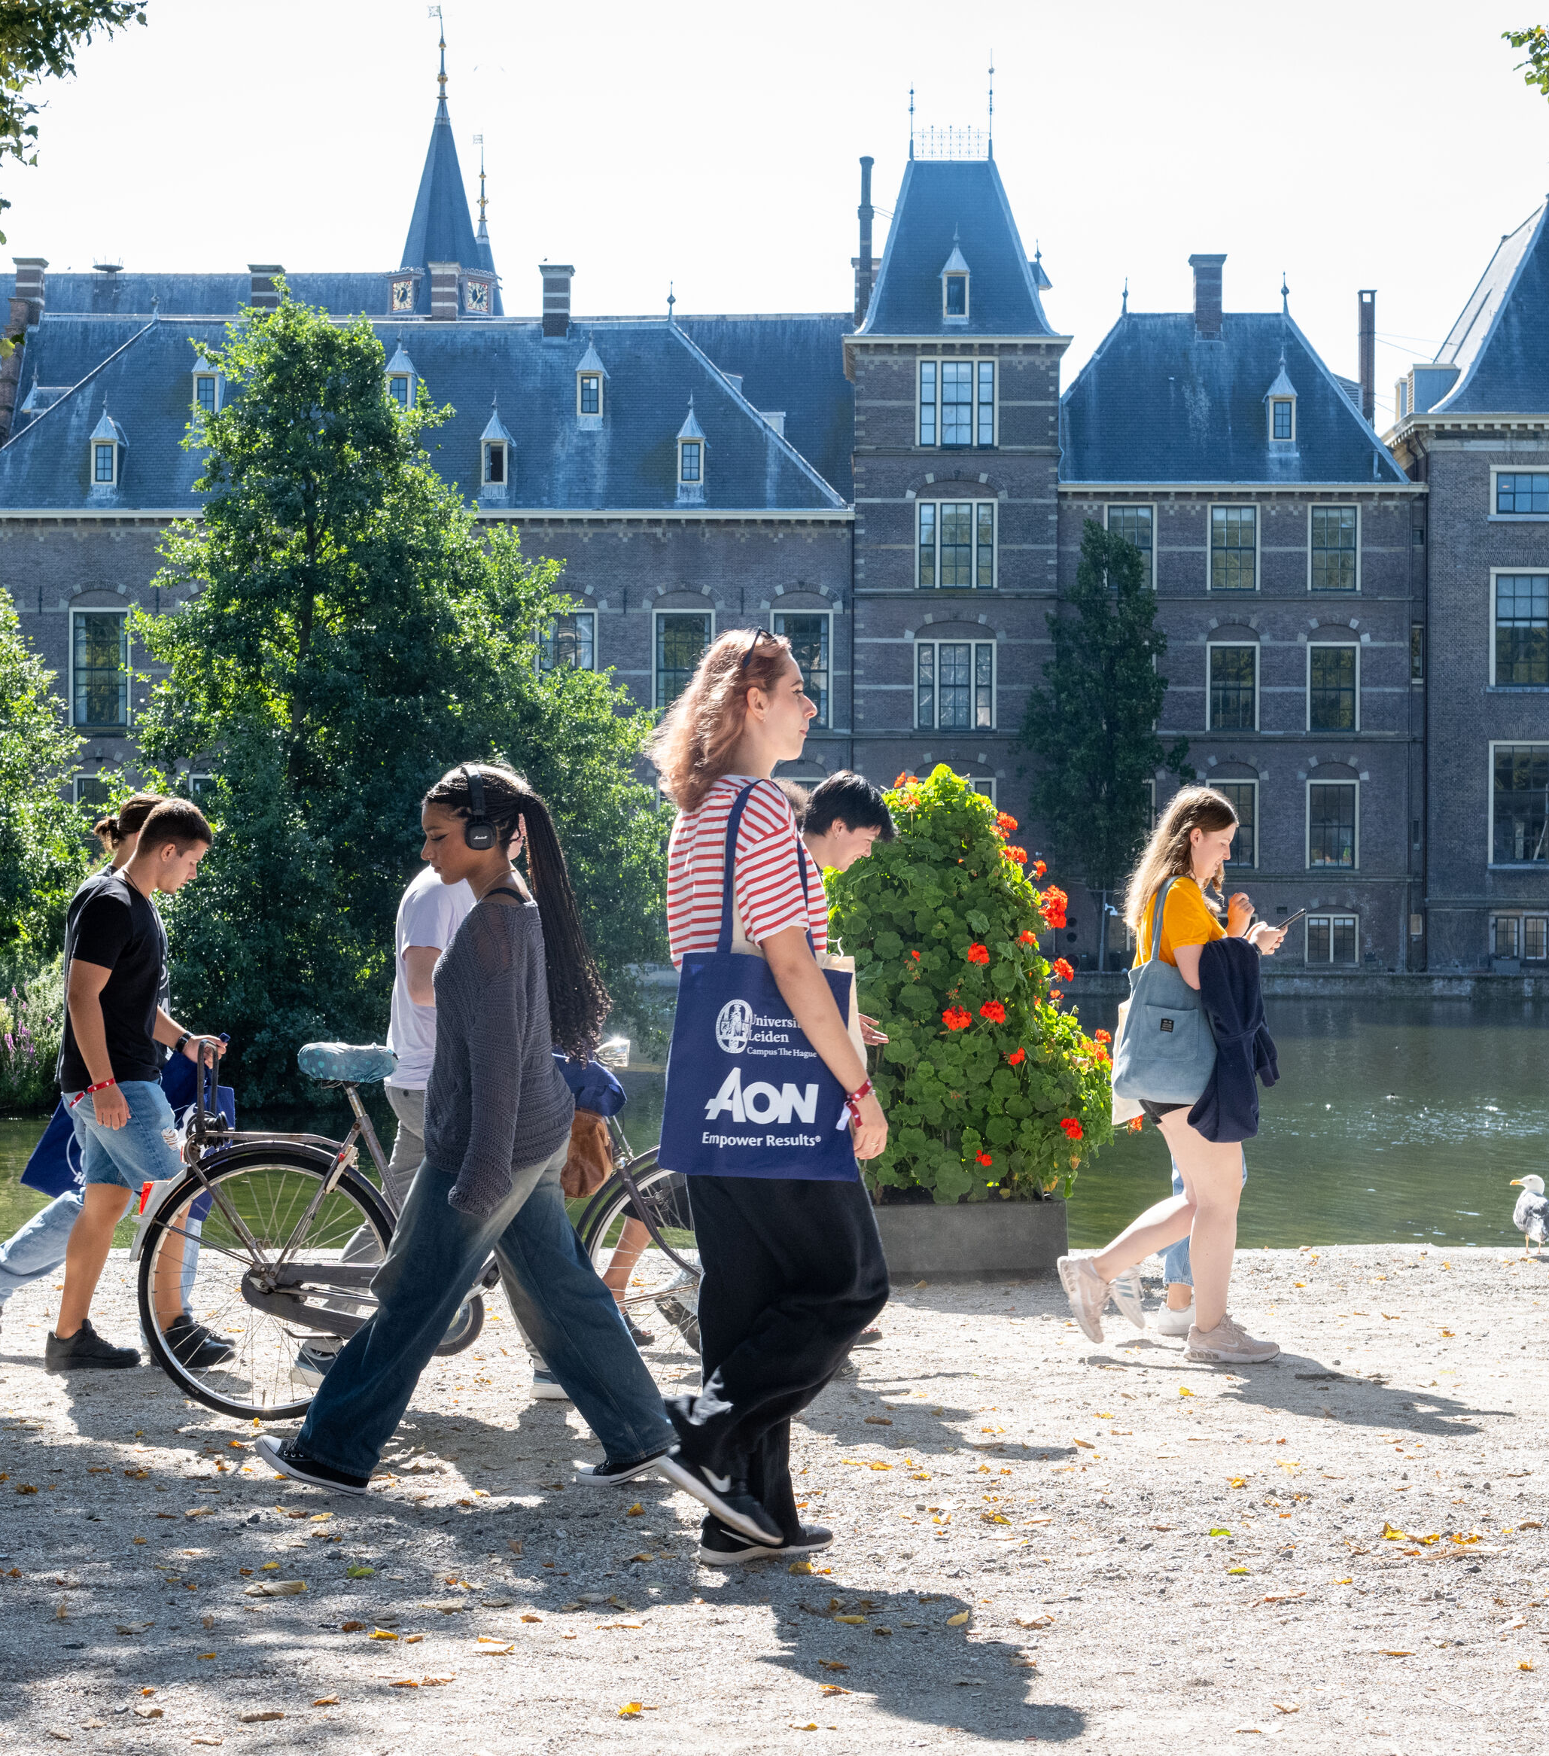
Partners in The Hague
Municipality of The Hague
Leiden-Delft-Erasmus Universities
Royal Academy of Art The Hague
The Hague University of Applied Sciences
Security Delta
Economic Board The Hague
The Hague city centre
The Hague Humanity Hub

Slide 43

Studying and student life

Slide 44
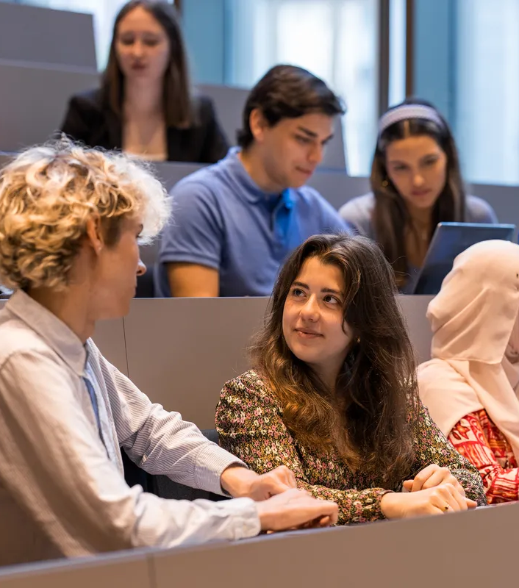
Why do students choose Leiden?
Wide range of programmes
Small scale
International
Research-based teaching
Friendly student cities
Good reputations
Notes:
Why do students choose us? Research has shown that this is what attracts them to our university. Thousands of students visit our open days with their parents each year.
https://www.universiteitleiden.nl/en/education/bachelors/information-activities/open-days
https://www.universiteitleiden.nl/en/education/masters/information-activities/masters-open-day

Slide 45
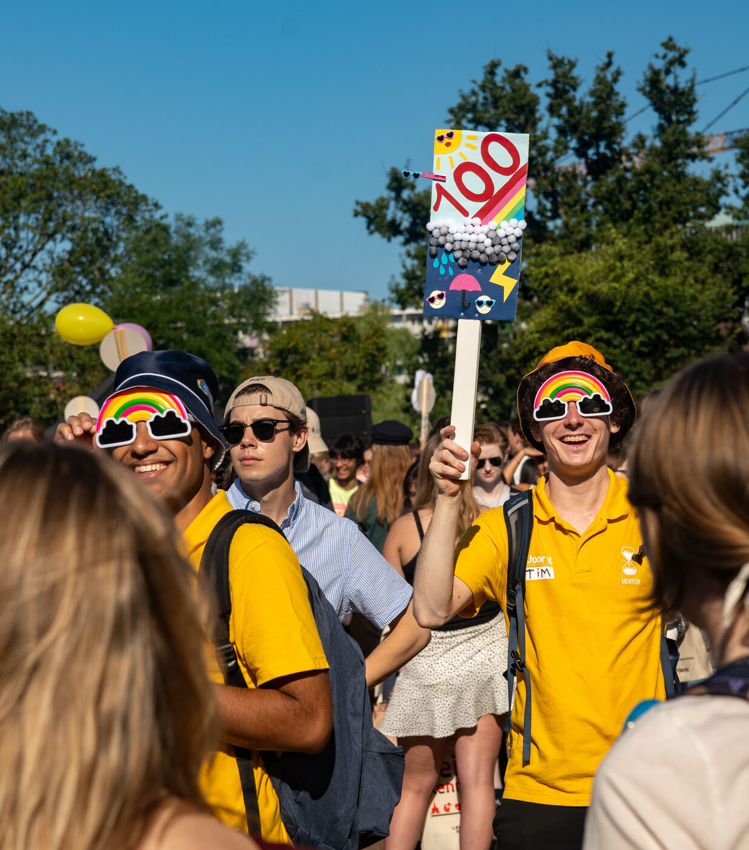
Active and engaged students
Participation and representation
Organise various activities
Community building
Student platform
Study and student associations
Notes:
Student participation
Students influence policy and decision-making at the university, faculties and institutes through the University Council.
https://www.student.universiteitleiden.nl/en/alongside-your-studies/student-participation
Associations, committees, voluntary work
We are proud of the many activities for and by students in Leiden and The Hague. These range from the introduction weeks (EL CID in Leiden, HOP in The Hague and OWL for international students) to student entrepreneurs in Lugus, to students who are active in their study association and organise excursions, study trips or job markets or the annual Museum Night in Leiden or who do voluntary work in Schilderswijk in The Hague. We support the many students who are active on the boards of their student or study associations with grants.
The Leiden University Student Platform (LUS)
The Leiden University Student Platform (LUS) is a student think tank that offers independent advice on university policy about all topics that affect students. To gain input from as many different students as possible, the LUS holds events where students discuss specific topics. The LUS communicates the findings to the Executive Board and other relevant bodies at Leiden University.
https://www.student.universiteitleiden.nl/naast-je-studie/medezeggenschap/leids-universitair-studentenplatform-lus
Associations
Leiden has an endless list of associations:
Study associations for each programme
General student associations
Internationale associations
Music associations
Sport associations
Cultural associations
The university works closely with the individual student associations. Joining a student association helps you feel at home in a new city and get to know a lot of new people.
https://www.student.universiteitleiden.nl/en/alongside-your-studies/associations?cf=university&cd=guest

Slide 46
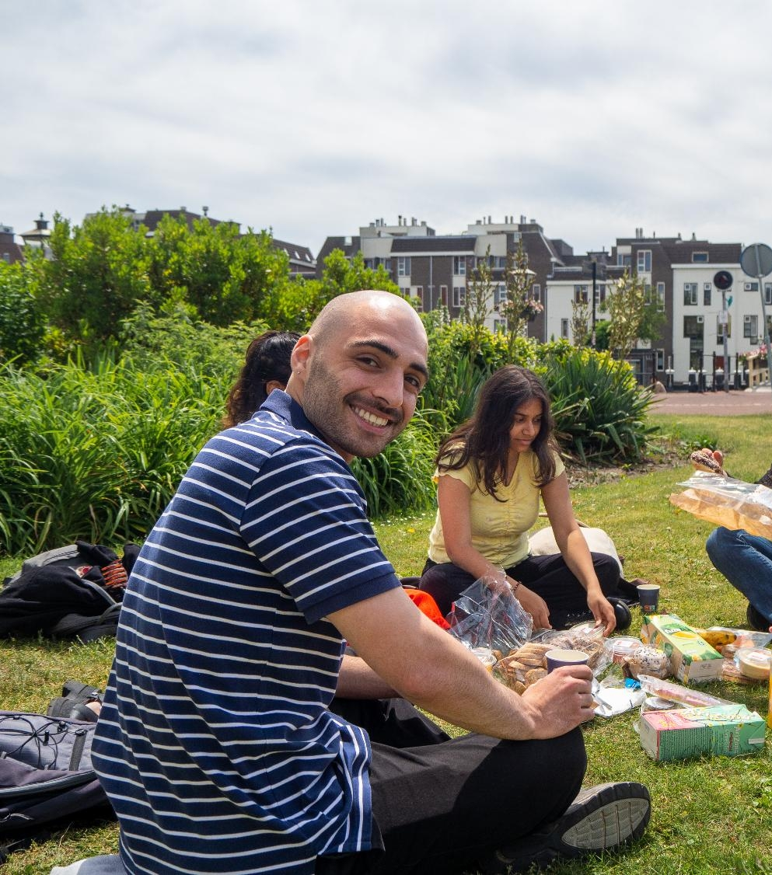
Student well-being
Well-being officers at the faculties
Fenestra Disability Centre
Meeting Points
Student psychologists
Study advisors
POPcorners
Well-being Moments
Well-being Weeks
Notes:
The university wants to help students who are facing personal or academic challenges. Each faculty has a well-being officer who is close to the students and organises a range of welcoming activities.
The student website has an extensive section on student well-being, with tips and tricks, training, workshops and contact details. It also provides an overview of the various facilities that students can make use of, including:
Fenestra Disability Centre, which advises students on studying with a disability or chronic disease.
Meeting Points, where students who are new to the Netherlands can meet others in Leiden and The Hague.
Student psychologists, who can support mental health, and study advisers, who are students’ first point of contact and can help if they are struggling to keep up with their studies.
POPcorners (Faculty of Social and Behavioural Sciences and Campus The Hague), which help first-year students find their way at the university.
Our monthly Well-being Moment, which on a student well-being topic, and our annual Well-being Weeks, with workshops that help foster resilience.
The Gezonde Boel platform, with over 100 self-paced e-health modules.
In 2022, the university signed the Student Well-being Declaration with the Municipality of Leiden, Leiden University of Applied Sciences, Local Chamber of Associations (PKvV) and the Study Associations Consultation Platform (StOP). The signatories agree to improve student well-being across the board.
https://www.student.universiteitleiden.nl/en/support/health-and-well-being?cf=university&cd=guest

Slide 47
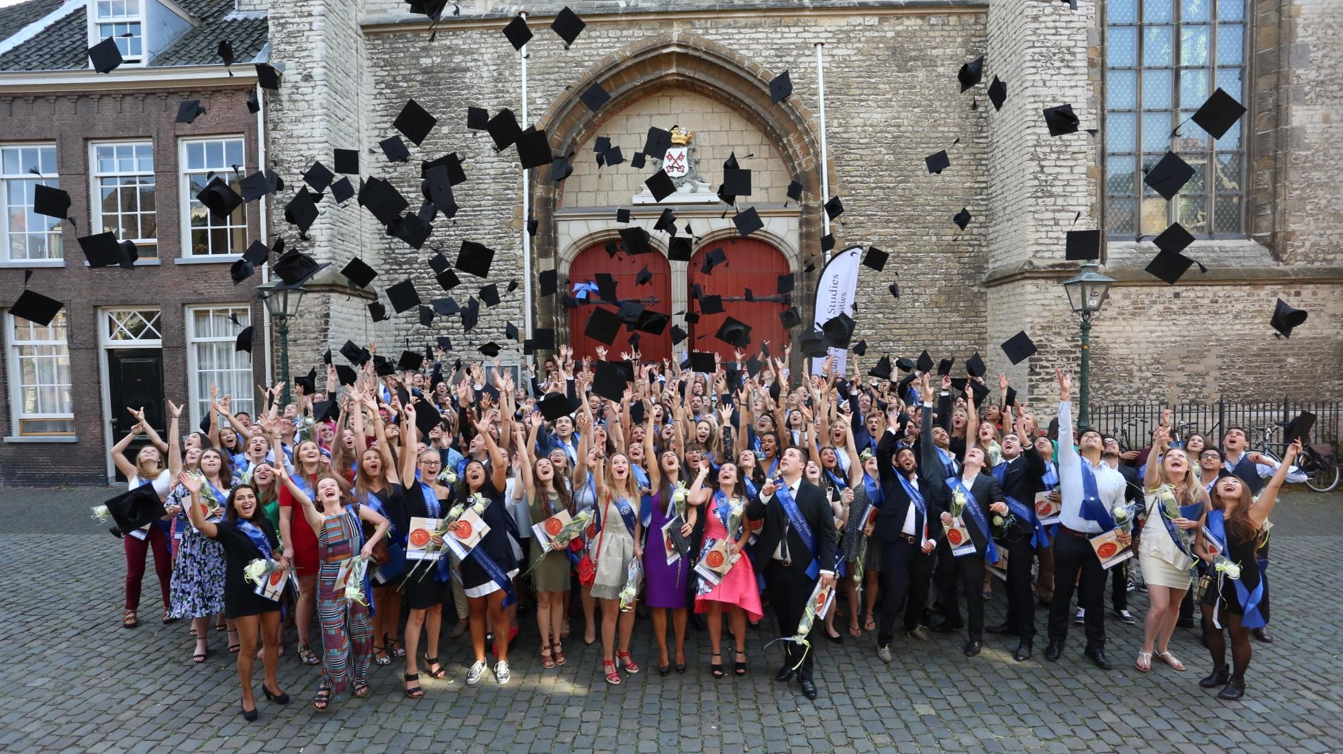
Alumni

Slide 48
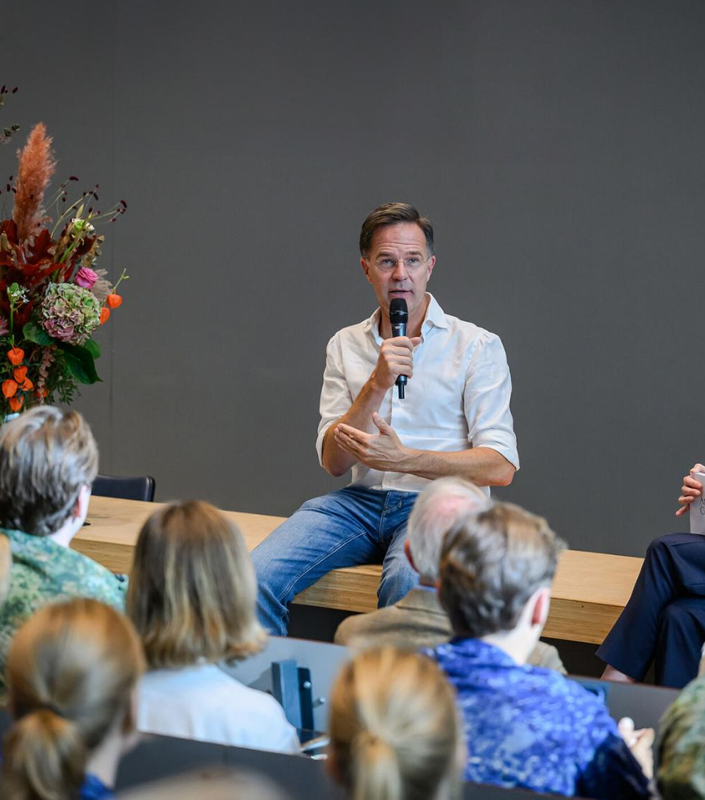
Our alumni
Over 155,000 in more than 150 countries
Famous alumni
Rembrandt van Rijn
King Willem-Alexander
Princess Beatrix
Mark Rutte
Eva Jinek
Notes:
Famous alumni: from Rembrandt, whose matriculation from 1620 can be found in our University Library, to members of the Royal Family and various ministers, state secretaries and MPs. Famous women who have studied at Leiden include presenter Eva Jinek and writer Franca Treur.

Slide 49
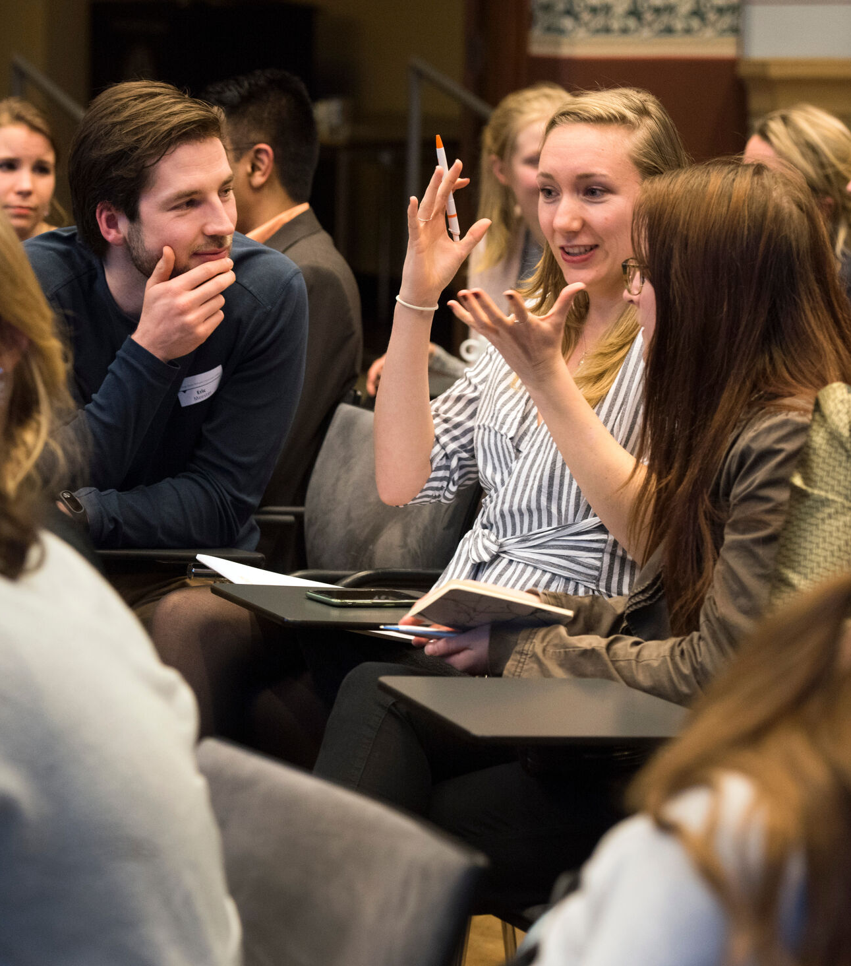
Our alumni offering
Personal and virtual networks
Careers guidance and mentor network
Leidraad Magazine
Notes:
Our alumni office keeps in touch with our alumni and sends them the Leidraad alumni magazine a few times per year. Our alumni come together in networks on LinkedIn, for example, but also in person, at our careers masterclasses, for instance.
Jong Alumni Network
This network gives alumni the opportunity to come into contact with other young alumni and share experiences, develop new skills and actively work on their careers. The network organises trips, workshops, lectures and coaching cafés.
(https://www.universiteitleiden.nl/alumni/alumnimagazine-leidraad)
(https://www.universiteitleiden.nl/alumni/educatie-carriere)
Mentor Network
The Mentor Network is for students and alumni.
Students: can sign up as mentee and receive careers advice.
Alumni: alumni can sign up as a mentee or a mentor.

Slide 50
HR & facilities

Slide 51
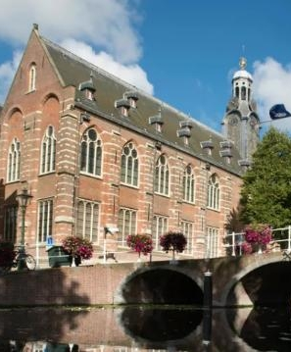
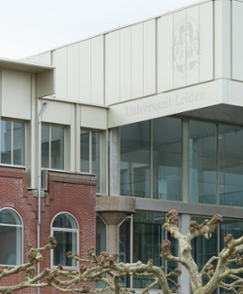
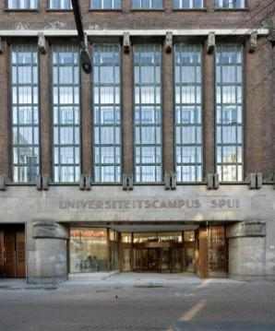
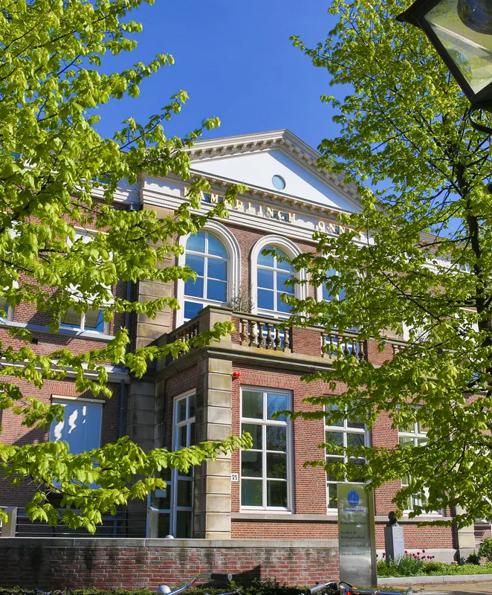
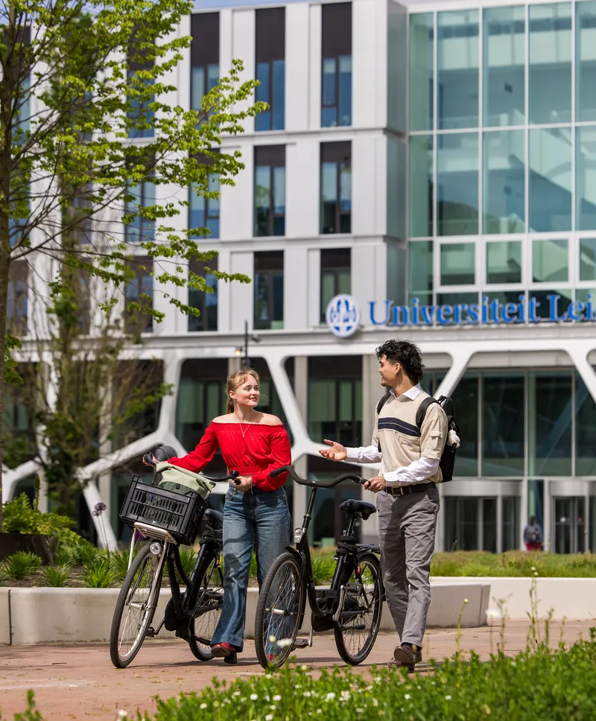
Our locations
Academy Building
Kamerlingh Onnes Building
Spui Campus
Herta Mohr Building
Gosssrlaeus Building
Notes:
The photos are of just a few of our around 40 locations in Leiden and The Hague.
We can be found at historic buildings (including the Academy Building – the university’s oldest building – the Hortus botanicus and the former university library) and state-of-the-art new ones. These include Wijnhaven and Spui Campus in The Hague (completed at the start of 2026), and the Science Campus in Leiden, which was completed in three phases, and the Humanities Campus, which is being constructed in four phases and will be completed in 2033.
https://www.universiteitleiden.nl/en/locations
https://www.universiteitleiden.nl/en/dossiers/building-projects

Slide 52
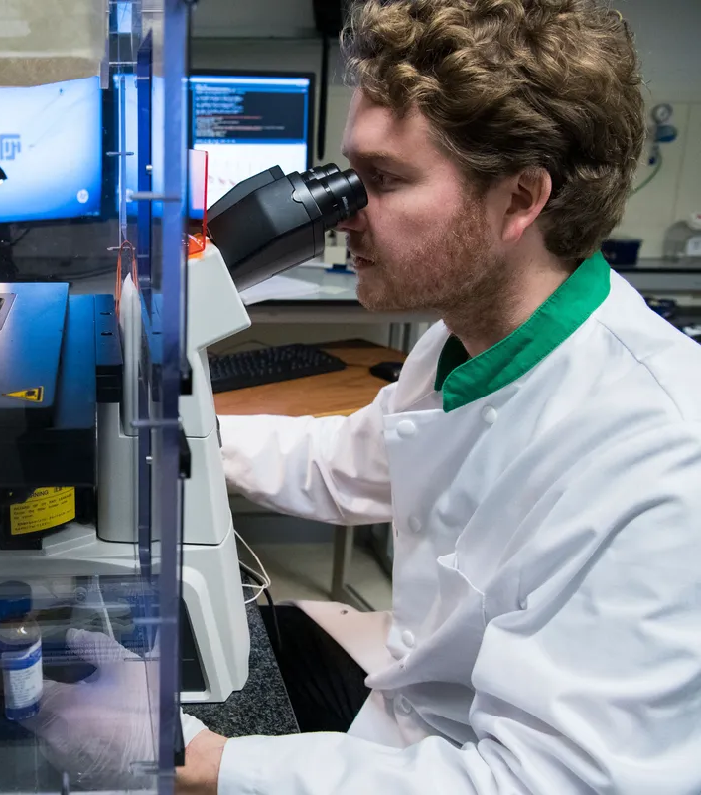
Research facilities
Laboratories and cleanrooms
Imaging facilities
High-performance computing
Animal facilities
Hortus Botanicus
Notes:
Laboratories & cleanrooms
We have modern scientific facilities (chemistry, biology, physics, pharmacy) with advanced equipment, and specialised cleanrooms for the production and characterisation of micro- and nanostructures.
Imaging facilities
Our advanced equipment such as MRI scanners, CT scanners, electron microscopes and confocal microscopes is used for research ranging from medical diagnoses to materials science.
High-performance computing (HPC)
We have powerful clusters of computers for complex data analysis, simulations and modelling, which are essential to disciplines such as astronomy, bioinformatics and theoretical physics.
Animal facilities
Our infrastructure for animal research meets strong ethical and legal standards.
Hortus botanicus
This iconic location that acts as a living laboratory for research on botany, evolutionary biology and biodiversity.

Slide 53
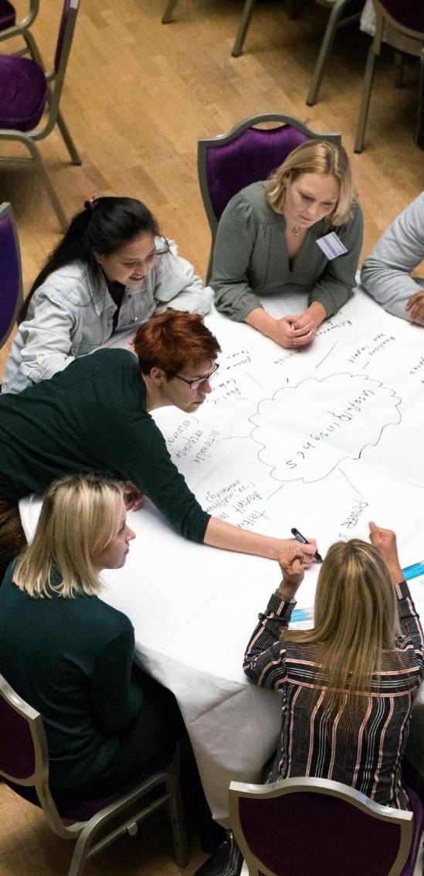
Human Resources
A healthy, engaged and continuously learning community
Academia in Motion: talent development and support for academics
Leadership and development
Psychological safety, work-life balance and well-being
Service Centre International Staff
Global Mobility
Notes:
A healthy, committed and continuously learning community
It is important to the university that our students, staff and alumni are able to develop and get the best out of themselves, personally and professionally. With our wide range of courses and training programmes, we want everyone to be able to develop, learn and grow.
https://www.universiteitleiden.nl/en/working-at/career-and-development
Academia in Motion
Academia in Motion supports the culture change needed to transform Leiden University into an open knowledge community with close ties to society where everyone’s contribution to our strategic goals is recognised and rewarded. Two key aspects of AiM are Open Science and Recognition & Rewards.
https://www.universiteitleiden.nl/en/dossiers/academia-in-motion
Leadership
Strong leadership is needed to create an open and continuously learning organisation.
We are working to create an open and learning organisation, a strong community where we trust one another, cooperate and take responsibility. This makes it important for all staff to invest in development and leadership skills.
https://www.universiteitleiden.nl/en/dossiers/leadership
Service Centre International Staff
This centre offers international staff a warm welcome and practical support for a stress-free start. This might include help applying for a residence permit or finding housing.
https://www.universiteitleiden.nl/en/working-at/service-centre-international-staff
Global Mobility
PhD candidates at Leiden University may spend time abroad for research, conferences, alliances or personal reasons such as a holiday. To ensure everything goes smoothly, the university has a global mobility policy.
Recognition and Rewards
In the coming years, Leiden University will work with other Dutch universities on new recognition and reward methods in the academic community. The focus should shift more towards responsible research assessment, balanced career development for staff, the promotion of all aspects of open science, and the advancement of high-quality academic leadership.
https://www.staff.universiteitleiden.nl/news/2022/05/dialogue-and-experimenting-to-make-recognition-and-reward-integral-tothe-whole-university?cf=service-units

Slide 54
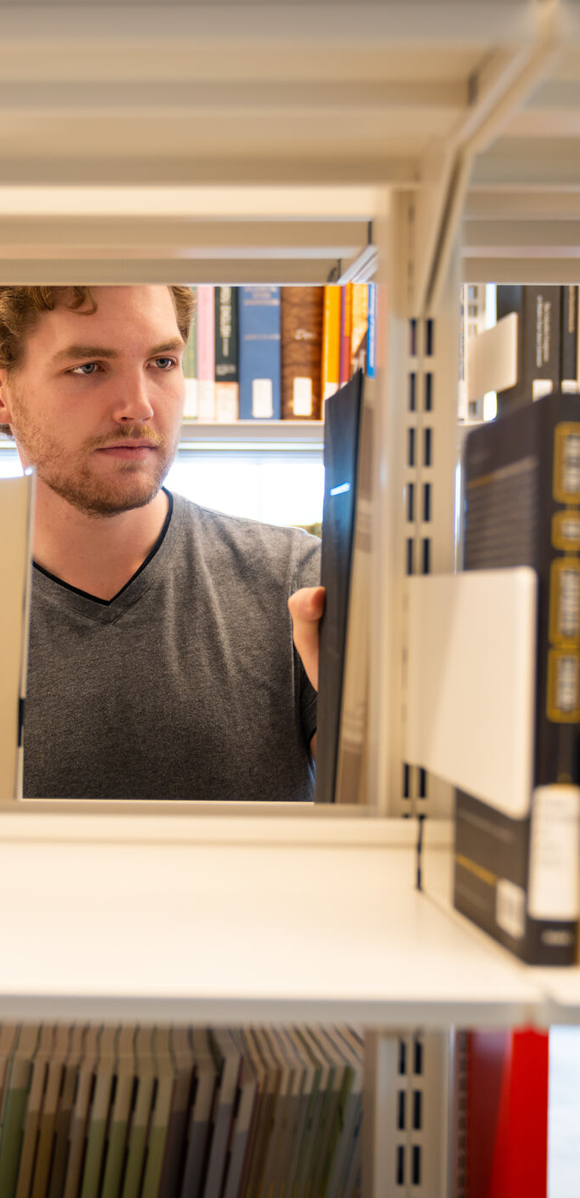
University Libraries
9 libraries in Leiden, The Hague, Rabat and Jakarta
5.5 million books and journals (print and digital)
1 million book loans
5 million catalogue searches
500,000 items in our special collections
7 collections with UNESCO World Heritage Status
500 international guest researchers and fellowships
Notes:
Leiden University Libraries is a leading international research library, renowned for its unique collections and advanced services that support research, teaching and learning.
The libraries’ special collections enjoy a global reputation, and, in addition to supporting research and teaching, fulfil an important social and cultural role.
https://library.universiteitleiden.nl

Slide 55
universiteitleiden.nl/en

