Slide 1
Discover Leiden University

Slide 2

First university in the Netherlands
Founded by William of Orange in 1575
Our motto
Praesidium Libertatis: Bastion of Freedom
Notes:
Leiden University was founded by William of Orange and its links to the House of Orange go back centuries. Legend has it that the people of Leiden were given the choice: no taxes or a university. Our logo features Minerva, the goddess of wisdom, bearing a shield and a book. This photo of Minerva is by photographer Erwin Olaf.
(https://www.universiteitleiden.nl/en/about-us/profile/history)
Freedom of speech and thought is fundamental to our university, and we have lived for centuries by our motto, Bastion of Freedom. Nelson Mandela, Winston Churchill and Princess Beatrix (the former queen of the Netherlands) have been awarded honorary doctorates for defending freedom.
(https://www.universiteitleiden.nl/en/about-us/profile)

Slide 3
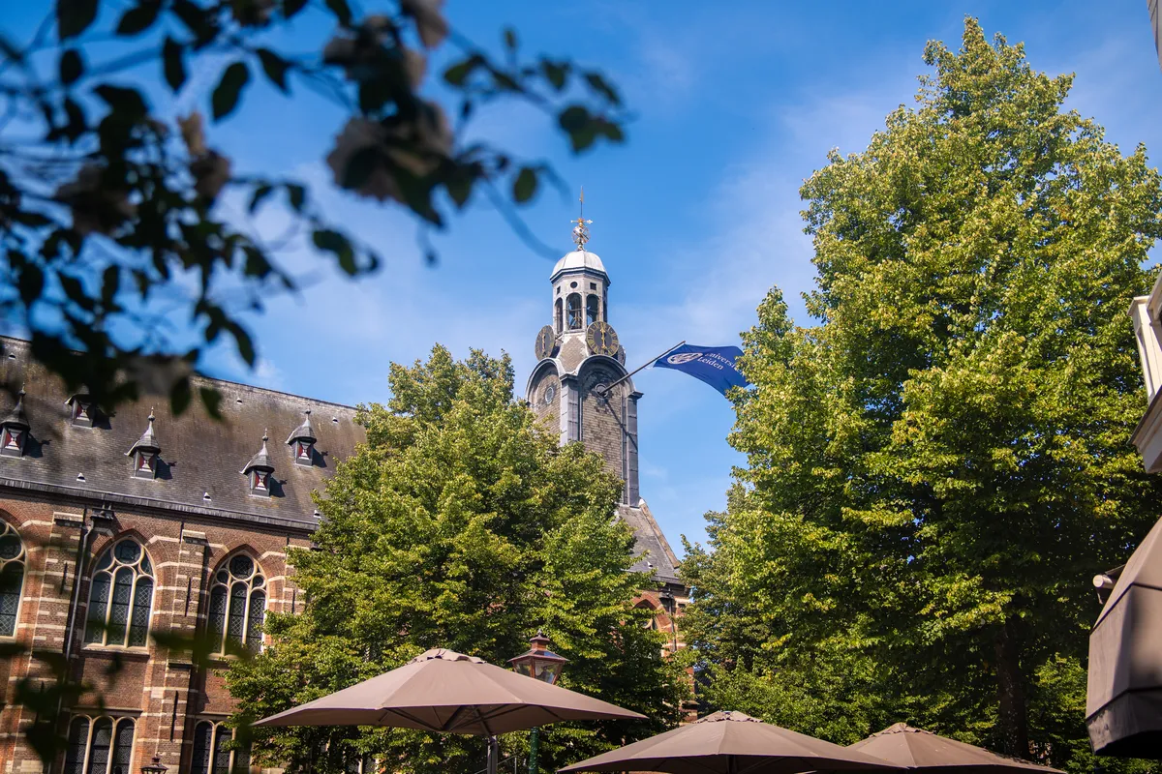
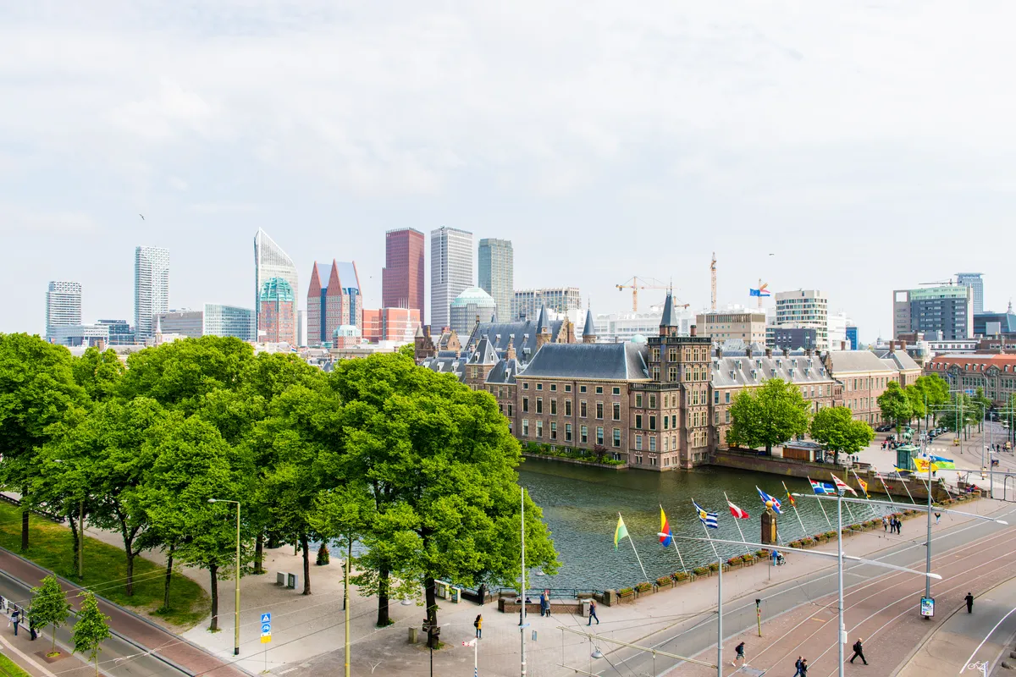
Two cities, one unique ecosystem
Medical Delta
Leiden-Delft-Erasmus Universities
Key Region Leiden
Campus The Hague
Leiden City of Knowledge
Leiden Bio Science Park
Unmanned Valley
Leiden
The Hague
NL Space Campus
Ministries and embassies
Spin-offs and start-ups
Local and regional government
Business community
Museums, culture and heritage
International
organisations
Peace, justice and security
Notes:
LDE
Since 2012, Leiden University, Delft University of Technology (TU Delft) and Erasmus University Rotterdam have collaborated through the Leiden-Delft-Erasmus (LDE) Universities strategic alliance to advance interdisciplinary and transdisciplinary research, education and operations.
LDE works with a range of organisations in a range of ways. These organisations are involved in partnerships, for example, or serve on the advisory boards of LDE centres. Others, such as government or industry, provide cases for students to study. Some of these partnerships go back years.
https://www.leiden-delft-erasmus.nl/en/home
Medical Delta
Medical Delta was founded in 2006 by the three LDE universities and the two UMCs (LUMC and Erasmus MC) in the province of Zuid-Holland. Four universities of applied sciences from the province (The Hague University of Applied Sciences, InHolland University of Applied Sciences, Rotterdam University of Applied Sciences and Leiden University of Applied Sciences) joined the collaboration in 2006.
https://www.leiden-delft-erasmus.nl/en/centres/medical-delta
Leiden City of Knowledge (Leiden Kennisstad)
Leiden University, Leiden University Medical Center (LUMC), Leiden University of Applied Sciences and the Municipality of Leiden decided in 2017 to intensify their collaboration, giving an extra boost to ‘Leiden City of Knowledge’. An evaluation of the project recommended continuing the collaboration, based on the following three themes:
Health & Well-being
Biodiversity & Sustainability
Cultural Heritage
These three themes build on the city’s strengths and relate to grand challenges that demand a national or global response. These themes should be viewed as a whole.
Key Region Leiden
Key Region Leiden (the successor to the Economie071 alliance) is a public-private partnership revolving around three leading innovation clusters, which together form the Leiden–Katwijk–Noordwijk knowledge axis. The clusters are as follows:
Leiden Bio Science Park (LBSP) – Focusing on bioscience, health and biotechnology.
NL Space Campus (Noordwijk) – Focusing on space technology and satellite data.
Unmanned Valley (Katwijk/Valkenburg) – Focusing on unmanned systems, sensors and drone technology.
NL Space Campus is the meeting place for the national and international space sector, with ESA ESTEC and the LDE universities as key partners.
Two cities
With a presence in two cities, Leiden and The Hague, our university is situated in the economic and administrative heart of the Netherlands and close to the international airport Schiphol, major cities, the Dutch coast and the centre of the EU.
Leiden
Historic city centre
Population of 130,000
City of Discoveries
Leiden Bio Science Park
Inner city campus
Museums
Six of our seven faculties
Approx. 35,000 students
Leiden is the city of discoveries, and university has been making its mark on there for over 450 years. It has two campuses and six faculties: Leiden Law School and the Faculty of Humanities in the city centre; and the Faculty of Medicine, the Faculty of Science, the Faculty of Social and Behavioural Sciences and the Faculty of Archaeology close to the Leiden Bio Science Park. Many of the museums in Leiden have close ties with the university. Six out of seven of our students study in Leiden and many live here too.
The Hague
Administrative and political capital with international organisations and embassies​
Population of 570,000
International City of Peace, Justice and Security
Campus The Hague
30 museums​
Seven faculties
Over 7,000 students
Since 1997, Leiden has also had a presence in The Hague, the third city in the Netherlands, which had no university before our arrival. Leiden is a university in two cities. All of our faculties are active in The Hague, and one faculty is solely located there: Governance and Global Affairs. The Campus The Hague strategy aligns closely with The Hague’s as a city of peace, justice and security and with the city’s metropolitan, national and international character. Many international students study here.

Slide 4
Faculties
Archaeology
Governance and Global Affairs
Humanities
Law
Medicine/LUMC
Science
Social and Behavioural Sciences
Notes:
Leiden University has seven faculties, located in both Leiden and The Hague. Within these faculties, academic research is carried out at various specialised research institutes. Leiden University has 36 institutes, four of which are interfaculty.
https://www.organisatiegids.universiteitleiden.nl/en/faculties-and-institutes

Slide 5
Leiden University in figures
2
Cities
7
Faculties
6,400
Staff members
51
Bachelor’s
programmes
83
Master’s
programmes
33,500
Students
156,000
Alumni
120
Nationalities
16
Nobel Prizes
Until now
Notes:
Figures from 2025 annual report
Exact numbers student and staff
Students: 33,494
Employees: 6,359

Slide 6
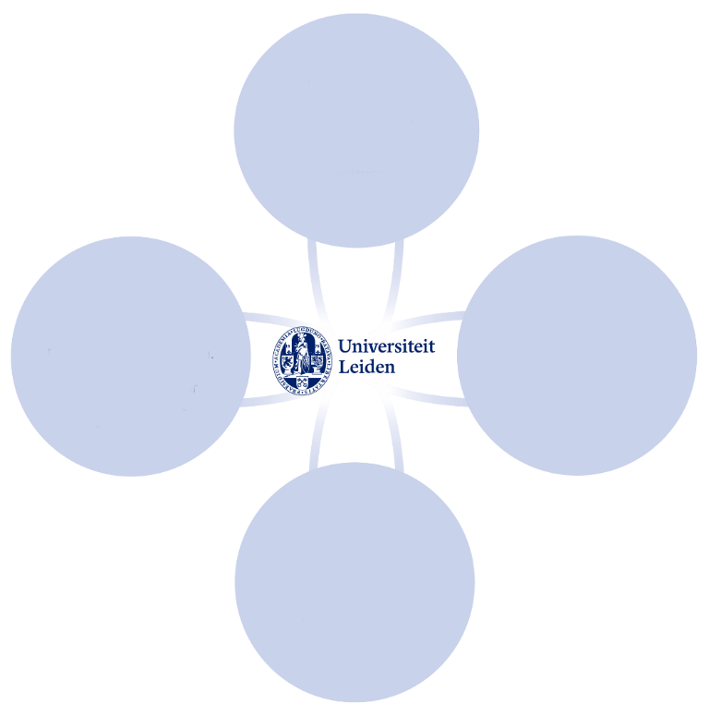
Innovating and Connecting
Strategic Plan 2022-2027
Room for innovation
Pioneering interdisciplinary research and teaching
Connecting
Future-proof student development
A healthy, involved and learning community
Innovative
Responsible
More value through strategic collaboration
Ample scope for talent and development
Free
Notes:
Strategic Plan 2022-2027. See strategischplan.universiteitleiden.nl/en
Innovative
Seeking new knowledge and understanding. Improving what can be improved. Shifting boundaries. Curious about one another and the unknown.
Connecting
Being part of a greater whole. Being successful together. Listening: to one another and to society. Actively contributing.
Free
Independent questioning. Offering scope for different perspectives and ideas, open discussion and curiosity-driven research.
Responsible
For promoting an inclusive community. For integrity in academic practice. For what we say and do, and how we interact with one another.

Slide 7
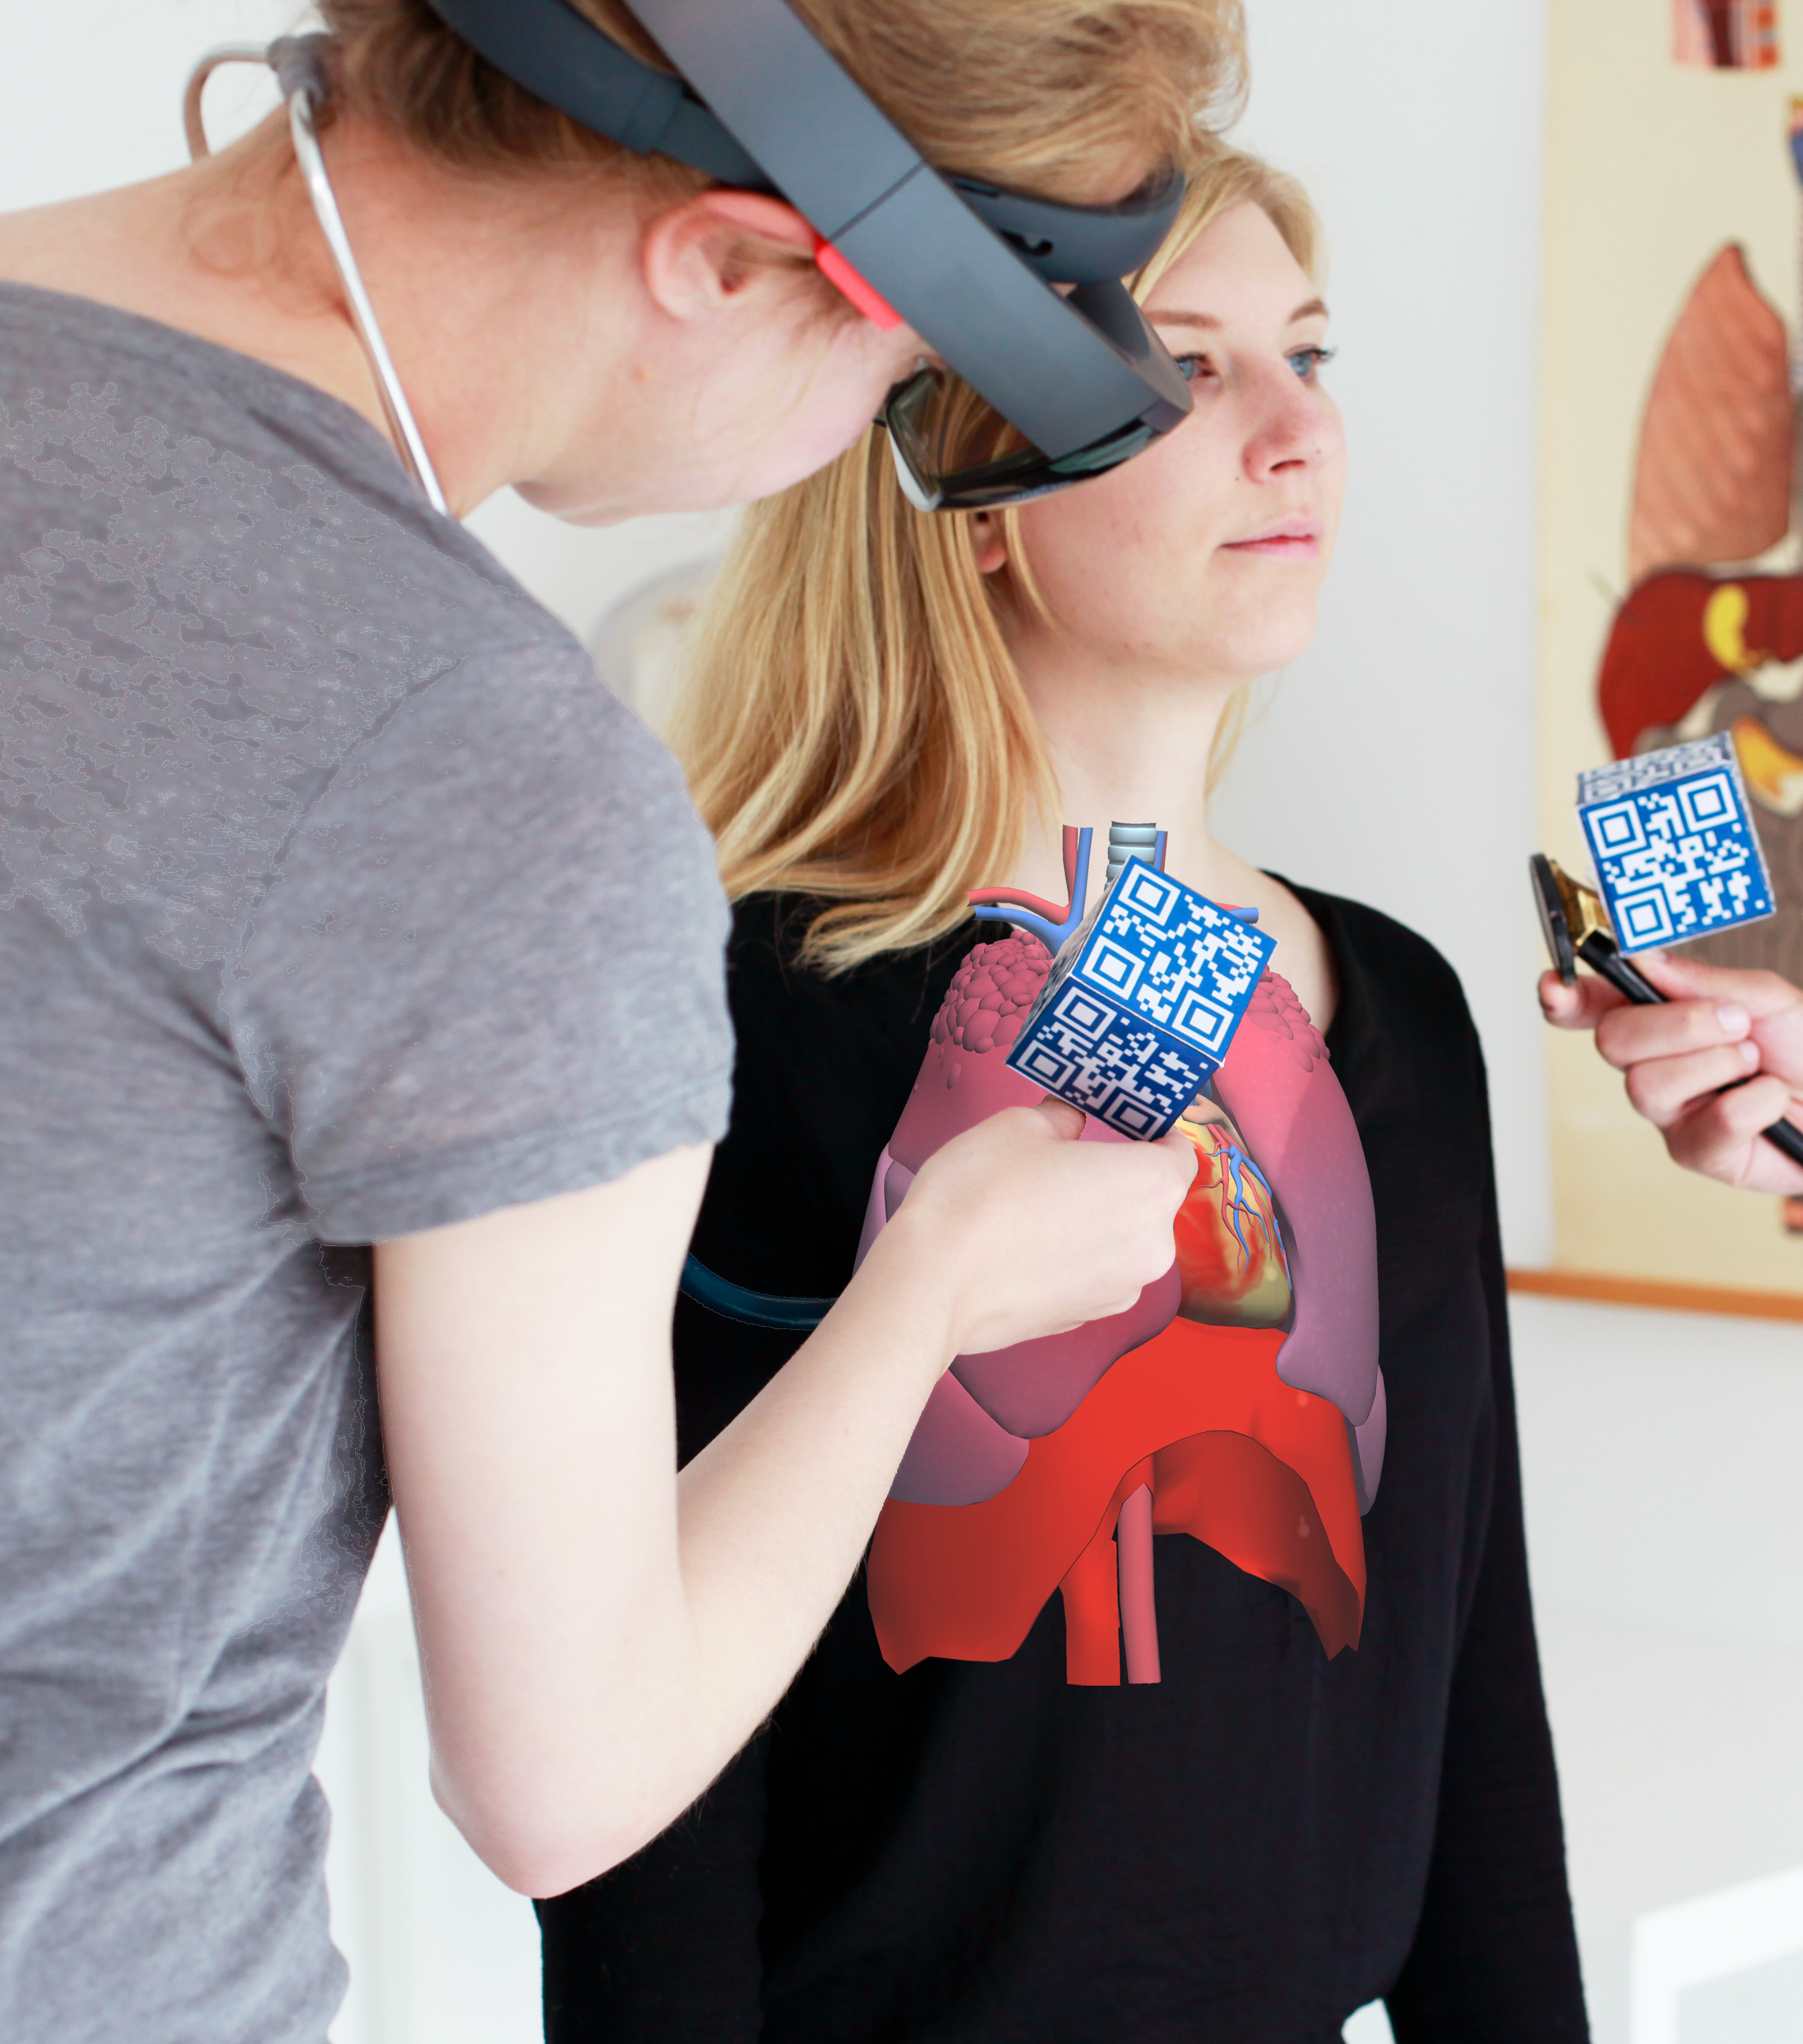
World-class research
Cutting-edge fundamental research
Interdisciplinary collaboration
Impact on society
International focus
Innovative teaching
Mono-, multi- and interdisciplinary
Focus on 21st-century skills
Relevant to society
Innovative use of technology
Notes:
RESEARCH
Our research is organised into 36 research institutes and spans a wide range of themes. Our research ranges from astronomy to nanotechnology, and from local to global challenges. We study urban issues in The Hague and children’s rights around the world.
Our Faculty of Humanities explores global languages, cultures and societies, our archaeologists uncover insights from the past, while our terrorism experts study today’s most pressing challenges.
Many of these issues are too complex for one discipline to solve. When researchers from different disciplines join forces, this results in new insights and solutions.
Our research has an impact on society. We use our knowledge to help address societal challenges, contribute to public debate and support policymaking.
TEACHING
We offer a wide range of mono-, multi- and interdisciplinary programmes. Our minors enable students to develop a multidisciplinary profile, and our new programmes are often strongly interdisciplinary.
With the world facing complex challenges that can rarely be solved by one discipline, our many interdisciplinary minors and programmes (e.g. International Studies) encourage our students to look beyond their own discipline.
We are integrating digital learning into our teaching. More than just online classes, this might involve interactive simulations, virtual environments and online collaboration tools.
Alongside research-based disciplinary knowledge, we place a firm emphasis on developing skills such as problem-solving, collaboration, communication and critical reflection. These are essential to a fast-changing job market and society, and their integration into the curriculum is innovative.
Many of our programmes and research projects have clear links to real-world challenges. Students are encouraged to think about the impact of their work on society and to seek solutions to today’s big issues. This contributes to a meaningful learning environment.

Slide 8

Profile of Leiden University
15 themes in 5 domains
Humans in the world | Resilient and learning society | Technology and society | Peace, justice, democracy and governance | Health and life sciences
Languages, cultures and worldviews Heritage Migration | Inequalities Generation of the future Social transitions | Sustainability and biodiversity Quantum and space AI for humans, society and science | Security, safety and cybersecurity Trust in polarised times Geopolitics in Europe and the world | Regenerative medicine Health and well-being Drug discovery and development
Notes:
Leiden University is a broad-based, international university. Our research and teaching is divided into five core domains.
https://universiteitleiden.nl/en/research

Slide 9
Research in figures
6,245
Publication
557
PhD defences
29
Spinoza Prizes
Until now
97
NWO Grants
15
ERC Grants
339
Professors
36% female
Notes:
Figures are from Leiden University’s annual report 2024
Curiosity-driven research – fundamental research in particular – is of great importance to Leiden University. Quality and excellence are guiding principles here. Our researchers are given the resources and space they need to excel. The number of highly cited researchers from Leiden per year is relatively high and above the global average.
Spinoza Prizes
Leiden University is in the lead: we have won 28 of the 111 Spinoza Prizes, the highest accolade in Dutch science, which is awarded by NWO.
(https://www.universiteitleiden.nl/en/academic-staff/leiden-spinoza-prize-laureates)
Distribution of ERC Grants
Synergy 1
Proof of Concept 5
Advanced 4
Consolidator 2
Starting 3
Distribution of NWO-vernieuwingsimpuls grants
Veni 18
Vidi 14
Vici 4

Slide 10
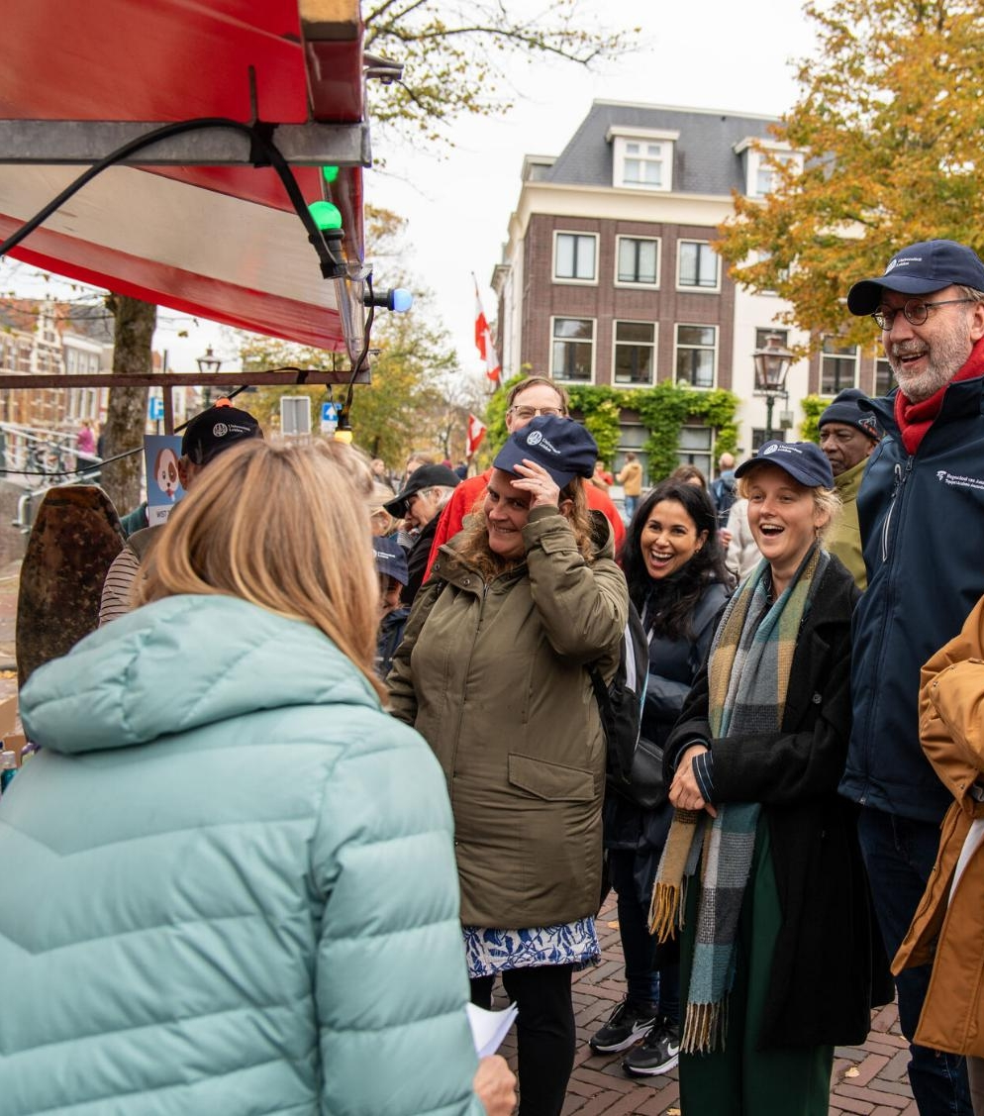
Innovation and knowledge transfer
Innovating with local, regional, national and international partners
Sharing knowledge to help solve the challenges of our time
Making science accessible to the general public
Notes:
Examples of partners
LOCAL
Leiden Bio Science Park
BioPartner Center Leiden
LeidenGlobal
Lorentz Center
Leiden City of Knowledge
Leiden Instrument Makers School
Leiden University of Applied Sciences
MBO Rijnland
REGIONAL
Leiden-Delft-Erasmus Universities
Collaboration with institutions in The Hague
Key Region Leiden
Medical Delta
NATIONAL
Universities of the Netherlands
INTERNATIONAL
League of European Research Universities
Una Europa
We work with many different partners at the local, regional and international level. We collaborate closely with the Leiden University Medical Center (LUMC) in our research and teaching (through our professors and medicine programme), and are one of the partners in Medical Delta, the Zuid-Holland alliance of universities, industry and government working in the life sciences and medical technology.
Luris connects researchers from the university and the LUMC with the market, and the municipalities of Leiden and The Hague help us develop our activities in the two cities.
In Leiden our researchers work with specialised businesses at the LBSP on discoveries and products in the life sciences.
In LDE, we work with Erasmus University and Delft University of Technology on joint research and teaching.
We are a member of LERU along with 23 other European research universities.
We offer joint programmes and research options together with the Royal Conservatoire and the Royal Academy of Art in The Hague.
And there are plenty more examples of collaboration: with the LUF, for example, our alumni fund.
Our research and teaching have an impact on society in various ways: we advance knowledge, we provide highly skilled graduates and our alumni make a difference to society. We work with the profession (many of our professors are active in their field outside the university), we carry out research for ministries and civil society organisations, we work with industry, for example at the LBSP.
Our accessible science reaches a wide audience: at Lowlands, during pop-up lectures or science cafés in The Hague, the Night of Discoveries, 3 October University, the Science Market on 3 October, Leiden Museum Night and with popular science books and appearances in the media.
We have an academic and professional impact, on the commercial and the government sectors. Our knowledge reaches a wide audience and our alumni are committed to society and education.
(https://www.universiteitleiden.nl/over-ons/impact)
https://www.universiteitleiden.nl/jaarverslag

Slide 11
Teaching in figures
33,500
Students
10,000
Graduates per year
51
Bachelor’s programmes
83
Master’s programmes
22%
International students
100+
Programmes for professionals
Notes:
Figures are from Leiden University’s annual report 2025
Exact number of students: 33,494

Slide 12
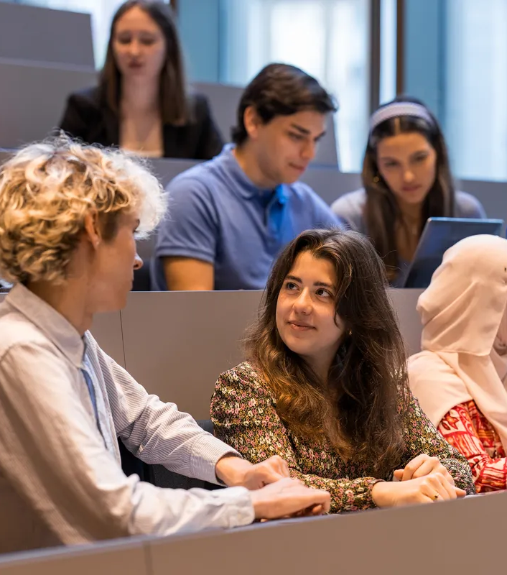
Why do students choose Leiden?
Wide range of programmes
Small scale
International
Research-based teaching
Friendly student cities
Good reputations
Notes:
Why do students choose us? Research has shown that this is what attracts them to our university. Thousands of students visit our open days with their parents each year.
https://www.universiteitleiden.nl/en/education/bachelors/information-activities/open-days
https://www.universiteitleiden.nl/en/education/masters/information-activities/masters-open-day

Slide 13
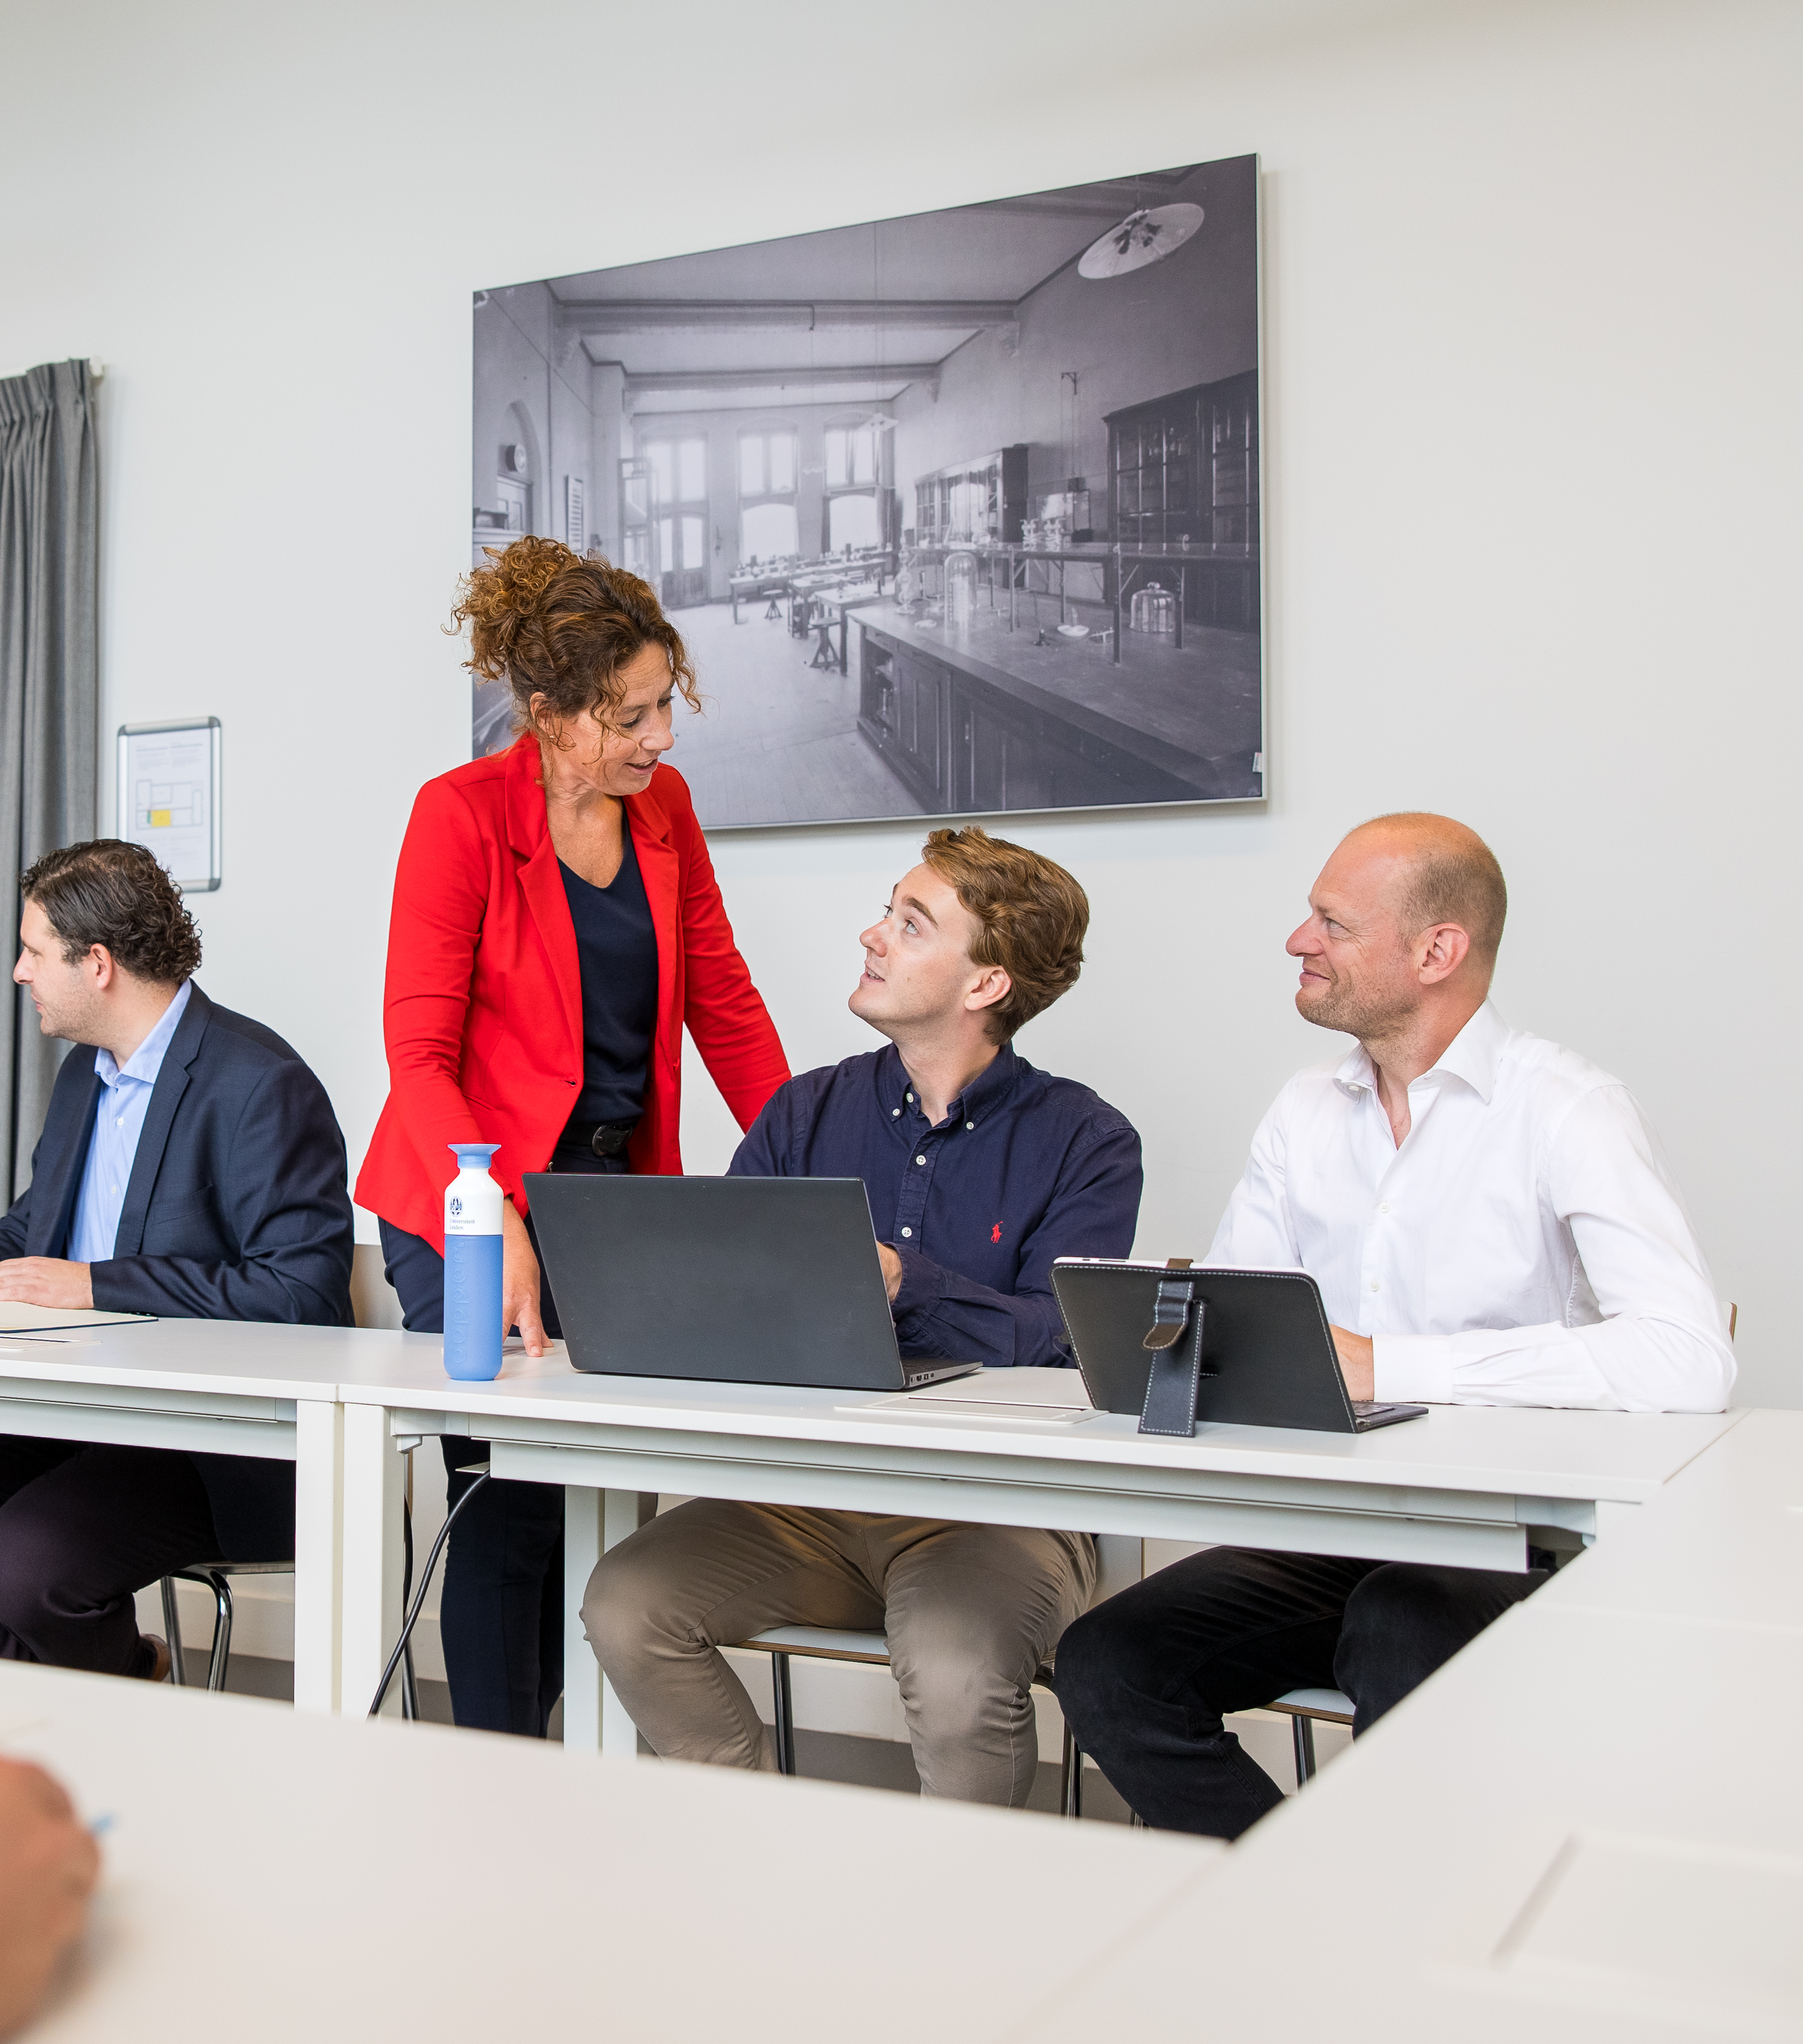
Lifelong learning
Professional education
Flexible learning
Courses for refugees
Study abroad
Summer schools
Notes:
We offer opportunities for adult learners, ranging from short courses for those looking to explore new ideas to longer programmes for those seeking to further their careers. From a one-off evening lecture and a course of a few months to a part-time programme spanning several years, there are many different ways to study at Leiden University.
https://www.universiteitleiden.nl/en/education/other-modes-of-study
https://www.universiteitleiden.nl/en/education/education-for-professionals
https://www.universiteitleiden.nl/en/education/other-modes-of-study/education-for-refugees

Slide 14

International collaboration
Focus on
Northeast and Southeast Asia
Latin America
Africa
Europe
Partnerships with
Academic partners
Non-academic partners
Notes:
Leiden University has always had partners across the world, with a particular focus on Europe, Asia, Africa and Latin America.
A global network of more than 600 universities and partners encourages our students to do part of their degree programme abroad.
Academic alliances foster research collaboration, student exchanges and talent development.
Non-academic partners include ministries and research councils
Alliances:
League of European Research Universities
Una Europa
Het Europaeum
European University Association
Euroscholars
Coimbra Group
Erasmus Mundus
International Association of Universities
(https://www.universiteitleiden.nl/over-ons/samenwerking/samenwerkingsverbanden/internationaal)

Slide 15
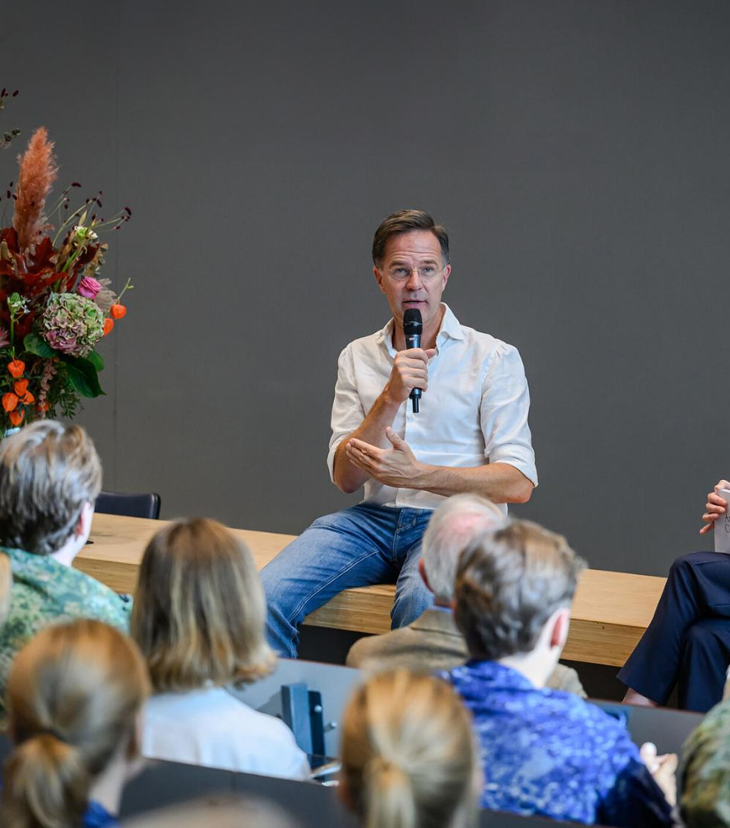
Our alumni
Over 155,000 in more than 150 countries
Famous alumni
Rembrandt van Rijn
King Willem-Alexander
Princess Beatrix
Mark Rutte
Eva Jinek
Notes:
Famous alumni: from Rembrandt, whose matriculation from 1620 can be found in our University Library, to members of the Royal Family and various ministers, state secretaries and MPs. Famous women who have studied at Leiden include presenter Eva Jinek and writer Franca Treur.

Slide 16
universiteitleiden.nl/en

